Slide 1
Impact evaluations and evidence-informed decision-making: experiences from Bogotá, Colombia
September 26, 2016
What Works Global Summit
Sebastian Chaskel, Country Director, IPA Colombia and Dominican Rep.
Carolina Medina, Co-founder, Agruppa
Daniel Ortega, Director, Impact Evaluation and Policy Learning, CAF
Chair: Arturo Galindo, Inter-American Development Bank
Notes:
Los retos a los que uno se enfrenta cuando no está institucionalizado el aprendizaje
Estamos en una conferencia para ver que funciona, un estudio no nos dice q funciona.
Explotar al máximo posible relaciones con policymakers e implementadores.
Reflexión es la importancia del trabajo de síntesis que se puede hacer posteriormente.
Las especificidades del lugar son muy grandres.
Primary study tiene importancia vital en acostrumbrar a las instituciones a hacer esto.
Este es un aporte a una discusiónmás amplia sobre la efectividad.
Tenemos q estar preparados maybe varies across places.
IPA es global.
Getting beyond the academic importance. Local incentives.

Slide 2
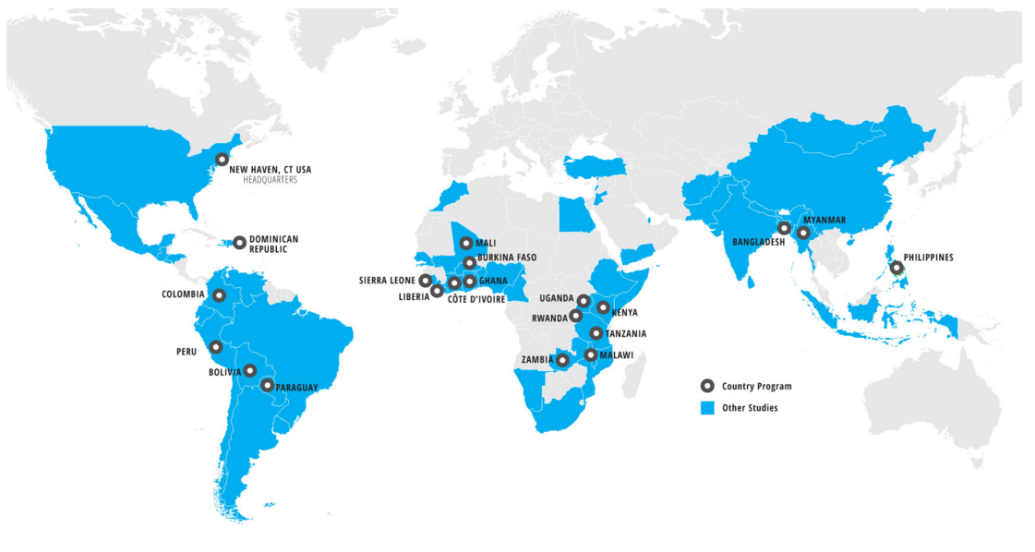
Innovations for Poverty Action
Notes:
In this slide, Sebastian will brieflly talk about IPA’s work around the world and what we do.

Slide 3
Two Very Different Experiences in Bogota

Slide 4
Notes:
In this slide, Sebastian will brieflly talk about IPA’s work around the world and what we do.

Slide 5
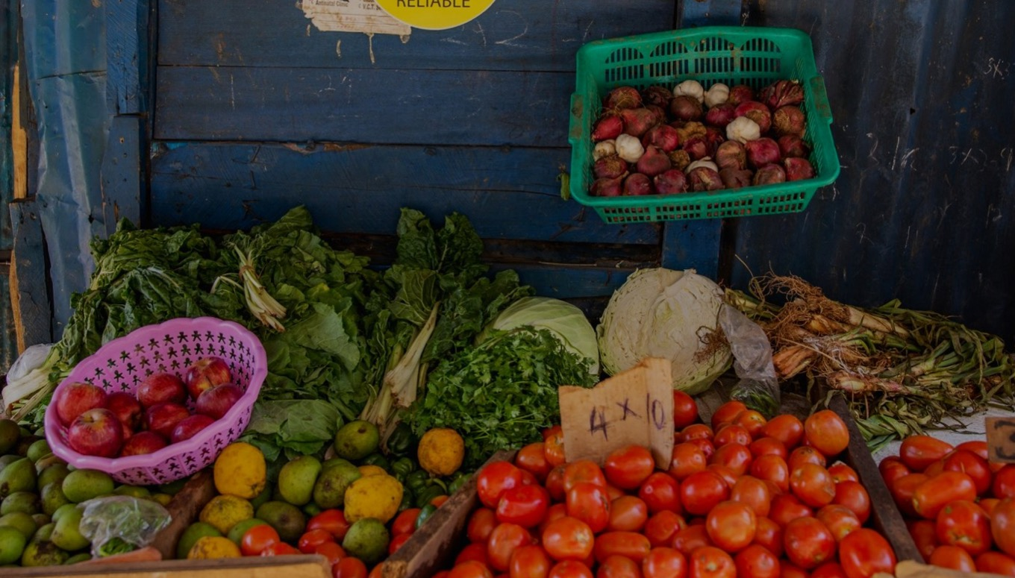
WWGS
SEPTEMBER 2016
agruppa.co · @Agruppa
Notes:
Carolina: Acá empieza la sección de Carolina. Hasta el punto de empezar la evaluación de impacto con el BM e IPA.

Slide 6
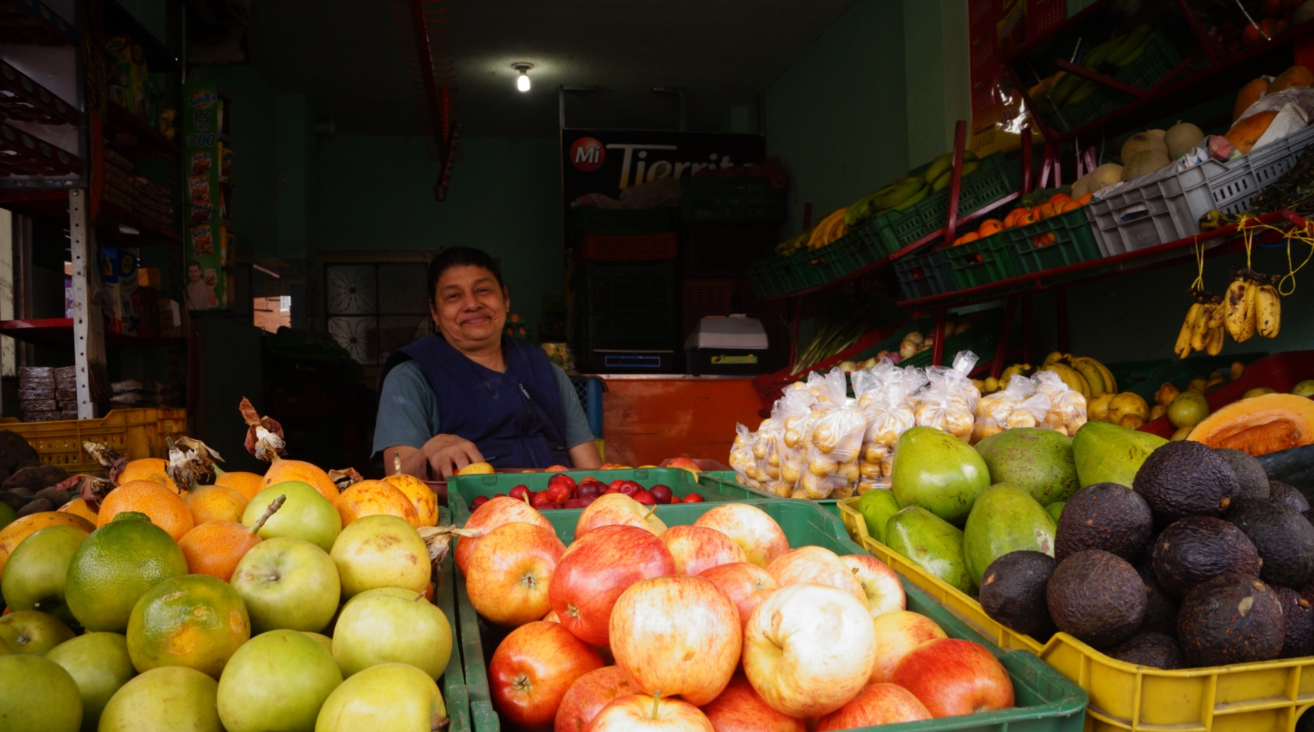

Slide 7
PROBLEM & OPPORTUNITY
340K
MOM-AND-POP SHOPS IN
COLOMBIA
70%
NO ACCESS TO WHOLESALE PRICES
OF FOOD IN THE REGION GOES THROUGH THESE SHOPS
YET
5M
MOM-AND-POP SHOPS IN LATIN AMERICA
*FAO (2010;) Crush & Frayne (2011); Ruel et al. (1998)

Slide 8
SOLUTION
Step 1
MOBILE
ORDERS
Step 2
AGGREGATE
DEMAND
Step 3
BULK
BUY
Step 4
DISTRIBUTION
WAREHOUSE
Step 5
DELIVERY TO
SHOPS

Slide 9
BUSINESS MODEL
Central Market
BEFORE AGRUPPA
Central
Market
Mom-and-Pop Shop
Farm
Up to 5 middlemen
WITH AGRUPPA
Buy
30% cheaper!
Transfer
10%+ discounts!

Slide 10
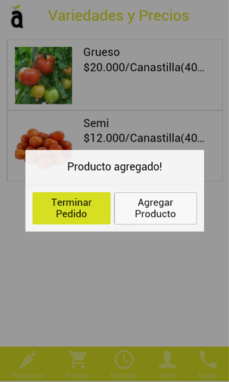
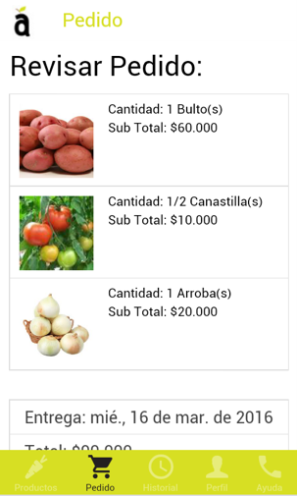
TECHNOLOGY FOR SCALE
FOR FOOD VENDORS
Mobile phone based ordering channel
App
Voice-based solution
Call Center
+
FOR AGRUPPA (INTERNAL)
Mobile + Web platform
Aggregation
Processing of orders
Customer profiles

Slide 11
ACHIEVEMENTS
180
430
8%
$200K
RECURRENT CUSTOMERS
TONS OF PRODUCE SOLD
SAVINGS PASSED DOWN*
TOTAL SALES TO DATE
* Savings on produce alone to the mom-and-pop shops, who then set their prices individually. Additional savings from lower time and money spent on transportation (total of around 15% savings).

Slide 12
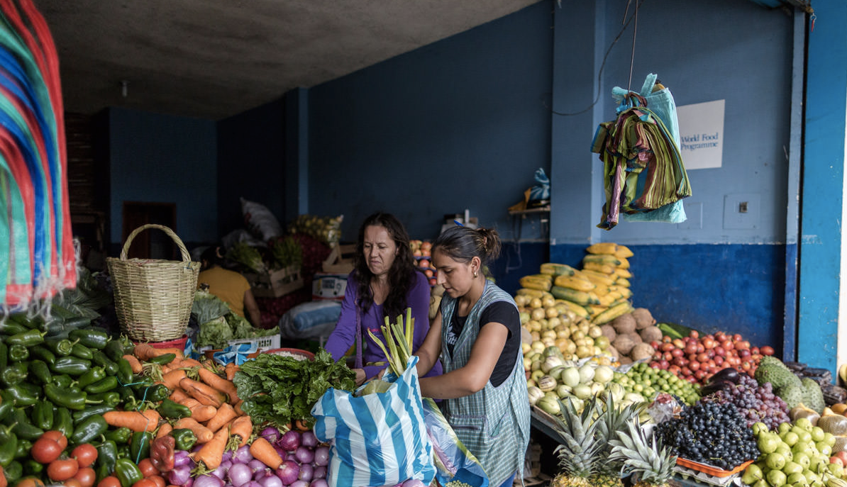
SOCIAL IMPACT
1
700
70,000
AGRUPPA WAREHOUSE
MOM-AND-POP SHOPS
END CONSUMERS
THEORY OF CHANGE
Input: cost savings (no transport + lower prices)
Output: higher income potential
Outcome: increased vendors’ sales & lower consumer prices
Impact: increased vendors’ livelihoods & contribution to food security for everyone

Slide 13
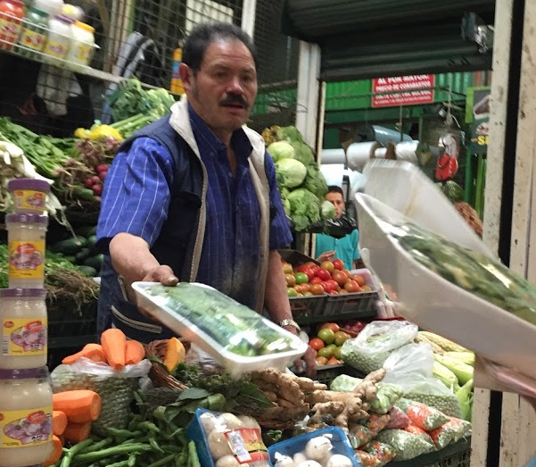
Using Technology to Improve Micro-entrepreneurs’ Supply Chain in Colombia
Principal Investigators: David McKenzie and Leonardo Iacovone, World Bank
Randomized evaluation of approximately 1,800 vendors in low-income neighborhoods in Bogotá
Evaluation funded by the World Bank and IPA’s Competitive Research Fund on Entrepreneurship and SME Growth
Notes:
Mom and pop shops
Stands
Carts

Slide 14
Research Questions
Can this technological solution overcome coordination issues among firms to reduce i) the amount of time they spend travelling to purchase inventories; ii) the price they pay for these inventories; and iii) the amount of spoilage/unsold inventory; resulting in iv) higher profits and higher incomes for their owners?
How much of the savings in costs is passed onto consumers?
Do vendors increase the variety of fresh food offered?
How do competitors respond to these changes?
Notes:
Value chain inefficiencies and coordination issues
Whether savings are passed on to consumers

Slide 15
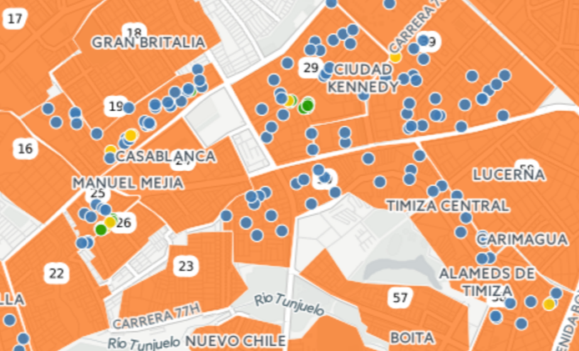
Research Design
Randomization at the “block” level with 30 T and 30 C blocks. Each block has approx. 40 stores.
Each block contains interested and not interested firms.

Slide 16
Research Design
Universe of 1,800 firms in 60 blocks
30 T Blocks
Group B:
15 interested
30 C Blocks
Group D:
15 uninterested
Group A:
15 interested
Group C:
15 uninterested

Slide 17
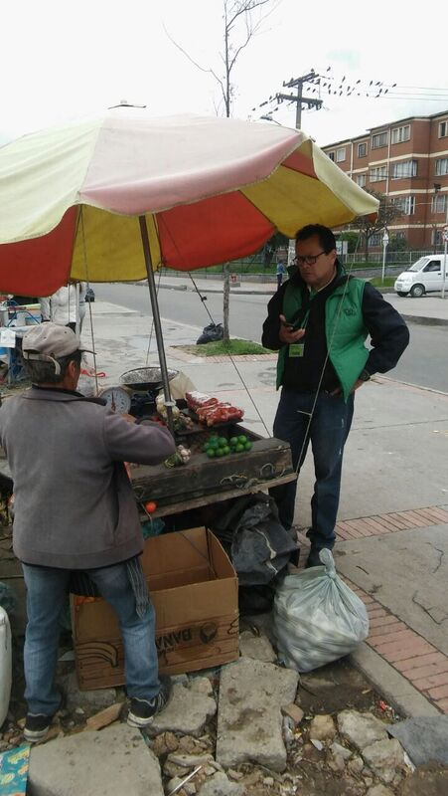
The Challenges of Gathering Data for this
Population
Many businesses are informal, and those that are formal are not reporting their correct incomes to the government. Therefore administrative data is unavailable.
Informal business owners are concerned the government may be collecting information from them in order to relocate them, close them, or tax them.
We are implementing 7 different data-gathering moments per business, which is exhausting.
Insecurity in Bogotá: Cell phones used for the survey may make you a target.
Business and product changes: Some businesses close, and others change the products they sell.
Price variance: Prices vary by the day. Therefore, T and C should be surveyed same day.

Slide 18
PROS OF M&E FOR STARTUPS
RIGOROUS IMPACT DATA
CONCRETE RESULTS
INFORMED DECISION-MAKING
IMPACT INVESTMENT
Notes:
Carolina: La palabra vuelve a Carolina para que describa su experiencia siendo parte de una evaluación de impacto.

Slide 19
CONS OF M&E FOR STARTUPS
ACTIVE CUSTOMER ACQUISITION
EFFICIENCY TRADEOFFS
OPTIMIZING OUR DELIVERY ROUTES
IMPACT INVESTMENT

Slide 20
WITHOUT IPA
retos de un Startup a la hora de medir impacto social
$, tiempo, energía, little agreement on what those metrics should be, it's a matter of resources so you'd end up developing some very different approaches (non rigorous) to measuring social performance.
Summary- the most rigorous measures of impact, which assess whether a program is actually changing conditions in the world, typically require expensive and time-consuming longitudinal studies.
> Agruppa es un caso poco representativo de los startups sociales)

Slide 21
CALL TO ACTION
alianzas (para emprendedores), contacto, pie adentro; invierta en M&E porque es invertir en la posibilidad. Impacto más que en el emprendedor (no cuesta mucho y puede ser una plataforma de ideas con impacto real)
- oír ideas
- startups = plataforma de innovación rápida (aprende rápido, falla rápido)

Slide 22
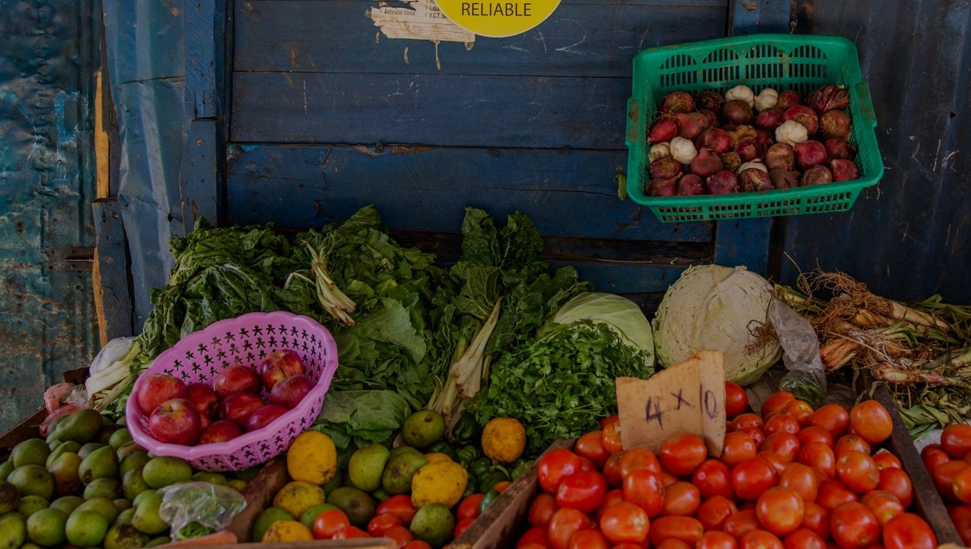
NEXT STEPS
Franchise or business-in-a-box model
Break-even
$100K
Grant
WHAT DO WE NEED?
We are raising $200K USD to close our seed capital round + looking for on the ground partnerships to add value to and measure our impact at the level of farmers.
Y5
Y4
Y3
Y2
Y1
CITIES
Bogota
+ Medellin
+ Bucara.
+ Barranquilla
+ Cali
# OF SHOPS
460
3.091
7.993
REVENUE
-$118K
$5.4M
$17.3M

Slide 23
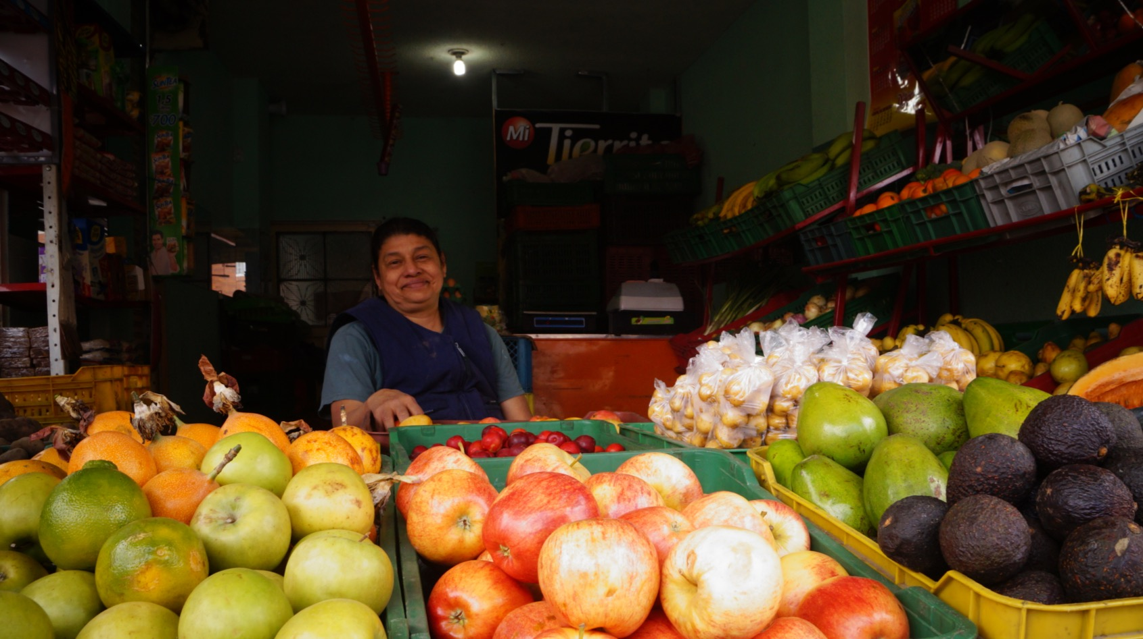
carolina@agruppa.co · agruppa.co · @Agruppa

Slide 24
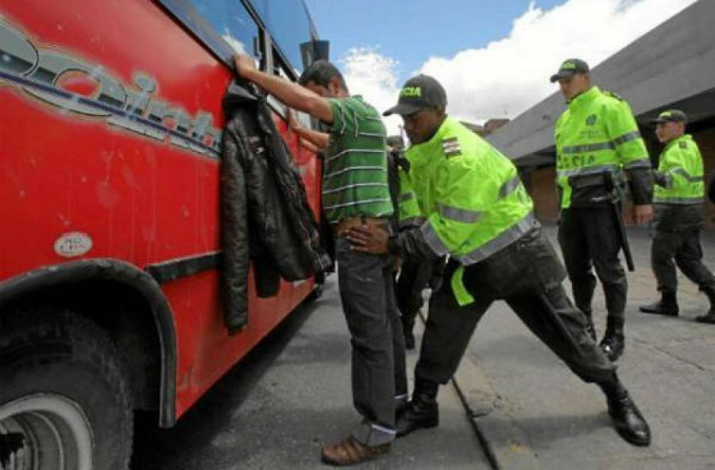
Improving Security through Concentrated Policing and Municipal Clean-Ups in Bogotá, Colombia
Principal Investigators: Chris Blattman, Donald Green, Daniel Mejía, Daniel Ortega, Santiago Tobón
Randomized evaluation with 1,919 high-crime streets in Bogotá
Evaluation funded by CAF-Development Bank of the Andes, J-PAL Governance Initiative, J-PAL Government Partnership Initiative and ProBogotá.
Photo source: Bogotá Mayor’s Office
Notes:
I want to talk about a different project in which IPA is collaborating with CAF. It is a hotspot policing RCT in Bogota which builds not only from a long research tradition in the US and the U.K., but also on a special circumstance that has allowed the development of a broader agenda

Slide 25
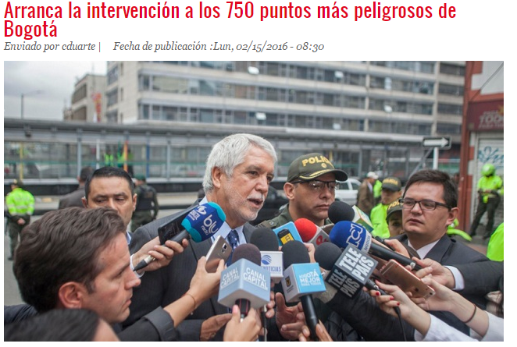
Background
In Bogotá, 59% of residents report feeling insecure.
Mayor Enrique Peñalosa started his term in January 2016 and immediately prioritized reducing crime and violence.
Notes:
The starting point is the election of a new mayor in Bogota, and the priority given to crime in response to the levels of perceived insecurity in the city

Slide 26
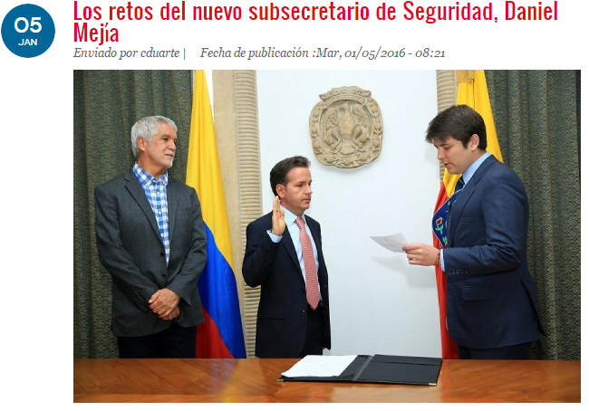
The Opportunity
Mejía, Ortega and Tobón had an opportunity to do a first evaluation in Medellín in 2014.
Mejía designation as Secretary of Security opened an opportunity to create an evidence and learning agenda with the Mayor’s Office.
This is only the first of many evaluations we expect to implement.
Notes:
The new mayor appointed an academic to lead the administration's security strategy. We had already been working on a hotspot evaluation in the city of Medellin which was the backdrop of this new policy learning experience, and we hope the first of many experiments that we will be able to run in Bogota in the area of crime prevention

Slide 27
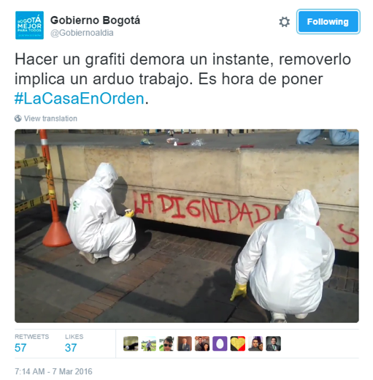
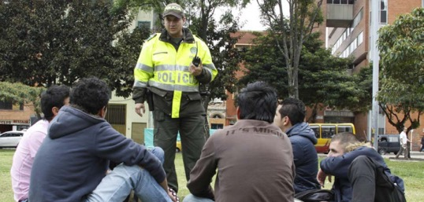
The Interventions Jointly Selected with the Mayor’s Office
Broken Windows Hotspot Policing
Notes:
So let me tell you a little bit about the intervention, it had a broken windows component and the regular hotspot patrol component

Slide 28
The Theory Behind the Interventions
Hotspot Policing
Celebrated in the United States and UK as effective.
More analysis of potential displacement effects is needed
Broken Windows Theory
Frequently brought up as a potential intervention to reduce crime and violence, evidence is thin at best

Slide 29
Our Sample
Identification of 1,919 most segments with highest level of crime (out of 137,000) and randomized into
Among the business as usual segments, we differentiate between those that are within 250m, 500m, and more than 500m from treatments.
Hotspot policing and broken windows
Broken windows: Cleaning of non-artistic graffiti, fixing of public lighting, and increasing trash pickup.
Hotspot Policing
Business as usual
Notes:
We first identified over 1900 hot spots throughout the city and randomized them across four groups

Slide 30
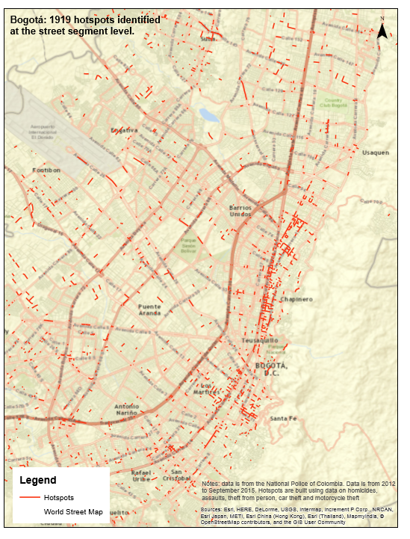
Notes:
This is what the map of these hotspots looks like

Slide 31
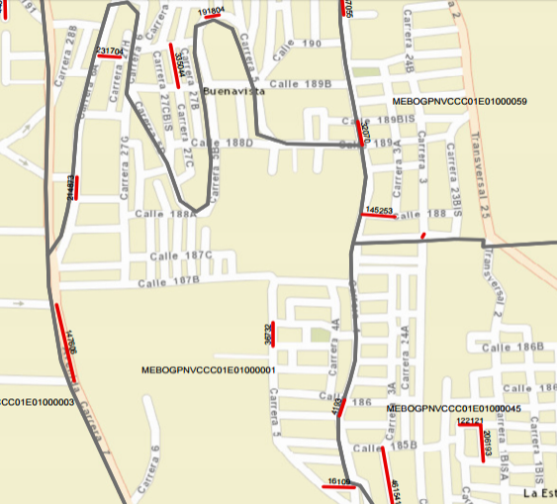
An Example in One Quadrant in Bogotá
Patroll X: September22, 2016: 14:22
Vehicle robbery:
September 25, 2016: 22:34
Pedestrian theft: September 24, 2016:
5:51
Notes:
And this is an example of a zoom into a particular area of the city with a couple of illustrations of events

Slide 32
Leveraging the city’s administrative data
Monitoring Data:
Geo-localized data on patrolling through PDAs that report every 30 seconds.
Information on PDA use, such as background checks using ID numbers.
Reports on garbage collection, graffiti cleaning, and public lighting maintenance.
Notes:
A good part of the data that we use for this project comes from administrative records. On the monitoring side it comes from GPS locations of each patrol at each moment in time throughout the project, also the number of background checks that each police officer does and in addition official reports of garbage cleaning and graffiti cleaning throughout the city

Slide 33
Leveraging the city’s administrative data
Impact Data:
Calls to police.
Reported crimes.
Arrests.
Time lapse in reports to police.
Notes:
We also use administrative data for measuring outcomes so official crime reports calls for service and registered arrests

Slide 34
Some Data Limitations
Sub-reporting.
City police is main data source for crime reporting, which may lead to perverse incentives.
Technological limitations.
Cannot see changes in perception.
May see impact on probability of reporting a crime, but not on crimes.
PDAs can be manipulated (leaving them in a corner store?).
Notes:
But the administrative data has some serious limitations, for example the very people who we are monitoring I are the ones responsible for producing the data, so we might see an increase in the probability of reporting a crime but not necessarily in peoples perceived risk of being victimized or the actual likelihood of them being victim of a crime. Also like any performance monitoring device PDAs are vulnerable to manipulation or gaming as it is sometimes called

Slide 35
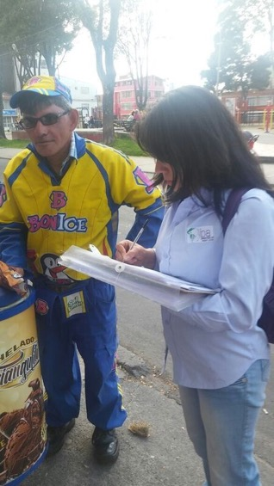
Citizen Victimization and Perception Survey
24,000 citizens in 2,400 segments: 1,919 hotspots and 481 randomly selected non-hotspots.
“Have you seen any of the following in this segment since
Christmas?”
“Since Christmas, has the police presence on this block
decreased, stayed the same, or increased?”
“If you become the victim of a crime, how likely are you to
report it to the police?”
Notes:
So this motivated our running a large scale survey across the city covering all of the 1900 hotspots plus nearly 500 non-hotspots, interviewing about 10 people at each street segment
The survey allows a direct measure of things like victimization perceived risk, police presence, willingness to report a crime, which is a measure of trust in the police…. These are all very important outcomes that we would want to measure in an intervention of this sort and that administrative data Does not allow us to

Slide 36
The Importance of Complementing Admin Data with Survey Data
Just looking at property crime:
Our administrative data show that being near (<250m) to a hotspot leads to a 6 percentage point increase in experiencing a property crime.
Our preliminary survey data, on the other hand, shows a 7 percentage point decrease in experiencing a property crime.
Notes:
So here's a simple illustration of the stark differences that you can find when looking at a mystery date up versus survey data. While the administrative data suggests an increase in the incidence of property crime the survey data shows exactly the opposite which suggests that the program is effective in reducing crime but also in increasing trust in the police as measured by the populations willingness to report

Slide 37
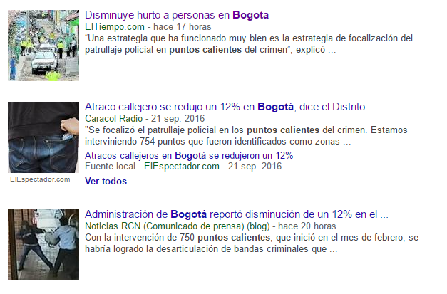
Managing Stakeholders and Timing
The mayor’s office
The media
The city council
How to manage expectations in which evidence-based decision-making is not commonplace?
Communicating and making evidence-based decisions is particularly challenging if intervention does not have desired impact.
Source: Google News, September 22, 2016
Notes:
One significant challenge that we've faced in this evaluation has been political pressure to deliver the results. We are lucky that the administration understands the timing of this process and has been able to fend off such pressures, however they are not totally immune.
Of course, this study along with the Medellin evaluation contribute to a growing literature on the effectiveness of targeted police patrol on reducing crime. They are the first studies in a developing country context, and will be key imputs in future updates of current systematic reviews of this strategy.
We have learned though that there are important missing pieces in the discussion about this sort of intervention. Specifically, the fact that after the evaluation period ends, police patrols go back to doing things the way they were doing them before even though sometimes the strategy proves to reduce crime. So what does this tell us about police incentives? How can we make them use this evidence? Is there something in the labor contract of police that does not make them value crime reduction as much as they should? What can be done to improve citizen trust in the police?
Ultimately, the question is how to advance evidence generation and uptake, and it seems to us that a key feature of any strategy has to involve a more significant engagement with policy makers, at every stage of the process.

