Slide 1
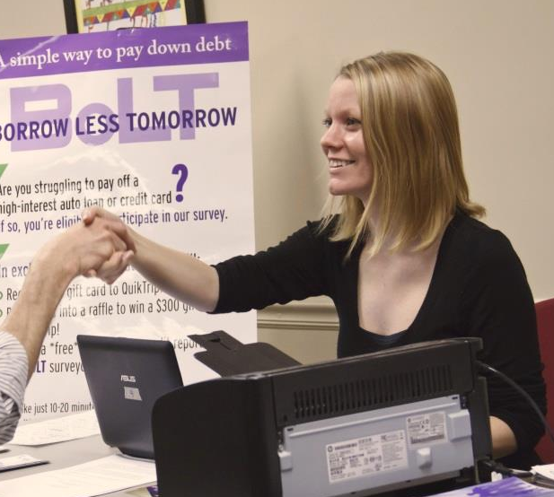
Better Decision-Making with RCTs:
A Guide for Financial Service Providers

Slide 2
Overview
Who we are
Experimentation with Randomized Controlled Trials
What is an RCT
Choosing metrics
Logistics
When are RCTs useful/when are they not
RCT Toolkit

Slide 3
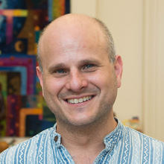
Introductions
Julia Brown
Program Manager
Kim Smith
Sr Research Associate
Nora Gregory
Research Associate
Lucia Goin
Research Associate
Jonathan Zinman, Dartmouth
Scientific Director
Dean Karlan, Yale

Slide 4
Where we work
51 Countries
Supported by 18 Country Programs

Slide 5
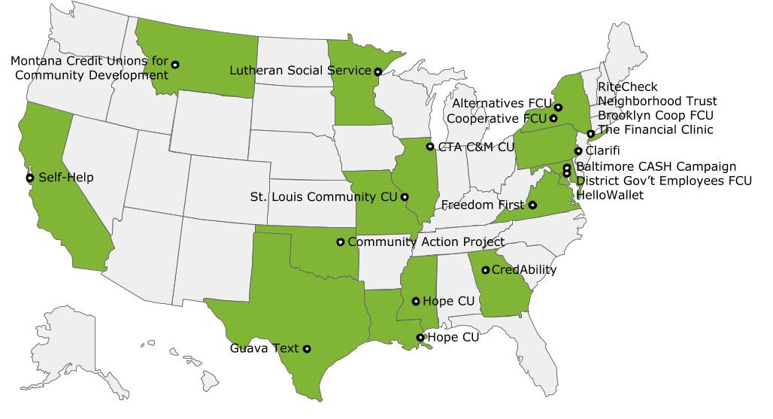
US Finance Initiative
26 Projects (8 RCTs, 18 Pilots)
22 Partner Organizations

Slide 6
THE PROBLEM
Limited Evidence
on what works best
Limited Use
of available evidence
Ineffective Policies and Programs
HiPPO Thinking
But we’ve always done it that way!

Slide 7
THE SOLUTION
Design & Evaluate
potential solutions to poverty problems
Mobilize & Support
decision-makers to use evidence
Better Policies & Programs
MORE EVIDENCE, LESS POVERTY

Slide 8
What is Impact?
IMPACT
of current practices
IMPACT of new
Products/services
Features
Marketing
On Your Bottom Line • On Your Clients • On Your Mission

Slide 9
What is Impact?
Program Start
Savings Balances
Time

Slide 10
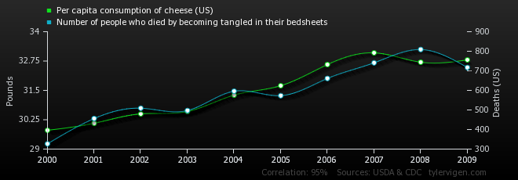
What is Impact?
Per capita consumption of cheese (US)
Number of people who died by becoming entangled in their bedsheets
Correlation: 0.947091

Slide 11
Did Not Receive Intervention
Received Intervention
Program Start
Average Income
Time

Slide 12
The Counterfactual
The counterfactual represents the state of the world that program participants would have experienced in the absence of the program (i.e. had they not participated in the program)
Problem: Counterfactual cannot be observed

Slide 13
The Counterfactual
Solution: We need to “mimic” or construct the counterfactual

Slide 14
Randomized Controlled Trials
COMPARISON

Slide 15
Impact is defined as a comparison between:
the average outcome for people who were in the program
--and--
the average outcome for the comparison group
Average savings balances for those who received text messages: $550
― Average savings balances for those in the comparison group: $325
Impact of text messages on savings: $225

Slide 17
Selecting Outcomes & Metrics
Outcome - What do you care about?
Improved savings behavior
Metric - How is it measured?
Number of savings deposits per month
Average size of savings deposit
Average daily balance of savings account

Slide 18
Selecting Metrics
OUTPUTS
OUTCOMES
Account openings
Message receipt
Web visits
Savings
Repayment
Income

Slide 19
Selecting Data
Administrative data
Demographic data
Transaction data
Credit report data
Survey data
Overall financial health

Slide 20
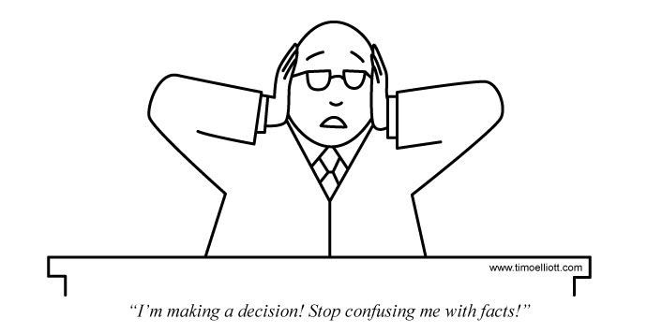
Selecting Metrics
Collect data that your organization will use
Set thresholds for success and failure before you start

Slide 21
Logistics – How many people do you need?

Slide 22
Logistics – How many people do you need?

Slide 23
Logistics – How many people do you need?

Slide 24
Logistics – How many people do you need?

Slide 25
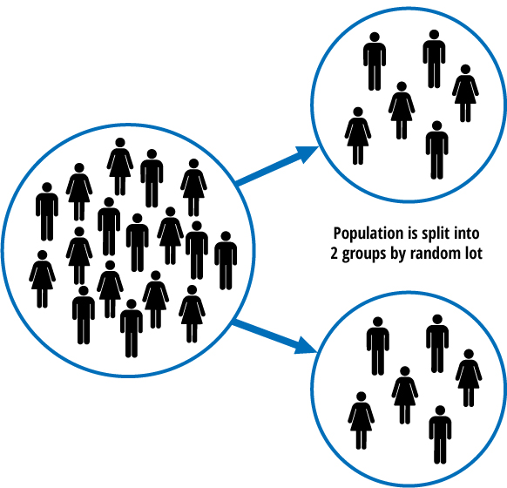
Logistics - Randomization

Slide 26
Example: Super Savers CD
Identify target population
Randomize
Control
Counseling
Savings
Collect outcome data

Slide 27
When NOT to Randomize
Sample size
Staff capacity
Intervention not ready to be tested
No feasible way of randomizing
No way of measuring outcomes
Organization not prepared to respond to results

Slide 28
When is the Right Time to Randomize?
When you have a good sense of needs, program theory, and process
When there is an important, specific and testable question you want/need to know the answer to
Time, expertise, and money to do it right
Appropriate sample size
Results can be used to inform programming and policy

Slide 29
The Role for Researchers
Sort through trickier RCT designs
Outsource some of the work
Objectivity and credibility
Creativity and experience

Slide 30
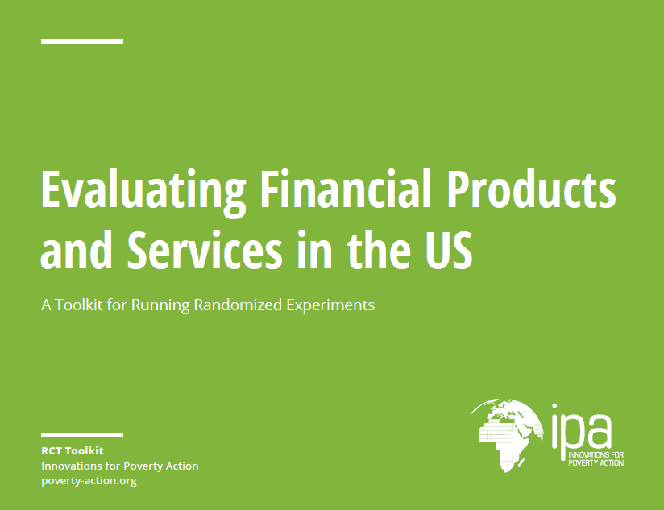
A Toolkit for RCTs

Slide 31
Thank You!

