Slide 1
Côte d’Ivoire RECOVR Surveys
Focus on Education

Slide 2
Outline for Presentation
RECOVR Overview
RECOVR Cote d’Ivoire Survey Information
Round 1 Key Takeaways
Round 2 Key Takeaways
Integrated findings from quantitative and qualitative surveys
Summary of Potential Policy Recommendations

Slide 3
IPA’s Research for Effective COVID-19 Responses (RECOVR)
Conducting a rapid response survey to answer key policy questions: IPA has built a rapid response panel survey to directly inform key government partners on the health, economic, and social ramifications of the pandemic, and is running it in eight countries.
Advising governments on evidence-based approaches: We are collaborating with dozens of governments and peer organizations to share information, resources, and data to inform global stakeholders and advocate for more funding to be allocated to economic responses, especially in the global south.
Curating a global hub that centralizes research and policy lessons: We are rapidly developing more than 80 new individual evaluations related to the COVID-19 response. Some build on existing studies, and others are new studies that have been quickly developed to inform the design of new programs aimed at mitigating the impacts of the crisis on health, livelihoods, learning, and other outcomes.
Notes:
The survey documents real-time trends of policy concern and will inform decision-makers about the communities that are hardest-hit by the pandemic.
For example, with Y-RISE, CEGA, and researchers, we are advising the government’s social protection responses in Bangladesh, Ghana, Nigeria, and Togo. And we are supporting education system distance learning responses in Ghana, Peru, Rwanda, and Zambia.

Slide 4
RECOVR Côte d’Ivoire
Partnerships with Ministry of Employment and Social Protection and Ministry of Education
Two multisectoral quantitative phone surveys
Random sample from Integrated Regional Survey on Employment and in the Informal Sector (ERI-ESI 2017)
One qualitative phone survey focused on education
Subsample selected to understand different users’ experience of distance learning options (Radio, TV, SMS)

Slide 5
RECOVR Côte d’Ivoire Quantitative Surveys
ROUND 1
Dates of survey: June 1 - 15, 2020
Sample size: 1,329 respondents out of 3,022 call attempts
Average respondent demographics:
Age: 40
% women: 32%
Household size: 6.4
% that completed more than secondary school: 37%
% Under national poverty line: 36% (Estimated with the PPI)
Notes:
The Poverty Probability Index (PPI®) is a statistically-sound, yet simple to use scorecard that lets us estimate the probability that someone is living below the national poverty line: The answers to 10 questions about a household’s characteristics and asset ownership are scored to compute the likelihood that the household is living below the poverty line. With the PPI, organizations can identify the clients, customers, or employees who are most likely to be poor, integrating objective poverty data into their assessments and strategic decision-making.
More information about random digit dialing: generate the cell phone sample from a database of all possible cell numbers based on Cote d’Ivoire’s cell numbering plan. All possible combinations of mobile telephone numbers are included, ensuring equal probability of selection. We engaged XXX, a firm that XXX

Slide 6
RECOVR Côte d’Ivoire Quantitative Surveys
ROUND 1
Dates of survey: June 1 - 15, 2020
Sample size: 1,329 respondents out of 3,022 call attempts
Average respondent demographics:
Age: 40
% women: 32%
Household size: 6.4
% that completed more than secondary school: 37%
% Under national poverty line: 36% (Estimated with the PPI)
ROUND 2
Dates of survey: October 22 - 30, 2020
Sample size: 994 respondents out of 1287 (about 77%) call attempts/consent from R1.
Average respondent demographics:
Age: 40
% women: 32%
Household size: 6.4
% that completed more than secondary school: 45%
% Under national poverty line: 36% (Estimated with the PPI)
Notes:
The Poverty Probability Index (PPI®) is a statistically-sound, yet simple to use scorecard that lets us estimate the probability that someone is living below the national poverty line: The answers to 10 questions about a household’s characteristics and asset ownership are scored to compute the likelihood that the household is living below the poverty line. With the PPI, organizations can identify the clients, customers, or employees who are most likely to be poor, integrating objective poverty data into their assessments and strategic decision-making.
More information about random digit dialing: generate the cell phone sample from a database of all possible cell numbers based on Cote d’Ivoire’s cell numbering plan. All possible combinations of mobile telephone numbers are included, ensuring equal probability of selection. We engaged XXX, a firm that XXX

Slide 7
Côte d’Ivoire RECOVR: Survey and Policy Timeline
Mar 16
Apr 16
May 16
Jun 16
Jul 16
Aug 16
Sep 16
Oct 16
Nov 16
Dec 16
Government enacts economic stimulus measures
16 Mar
Government announces additional economic relief measures
Legend
31 Mar
World Bank issues $35 million for pandemic response
Public Health Measures
5 May
Economic Measures
Facemasks required in public
IPA RECOVR
10 Apr
Reopening of educational institutions in interior
8 May
Education Schedule
Reopening of educational institutions in Greater Abidjan
Closure of Educational Institutions
25 May
16 Mar-25 May
Border Closures
School Summer Holiday
22 Mar-30 Jun
July - 14 September
Nationwide Curfew
23 Mar-15 May

Slide 8
Côte d’Ivoire RECOVR: Survey and Policy Timeline
Mar 16
Apr 16
May 16
Jun 16
Jul 16
Aug 16
Sep 16
Oct 16
Nov 16
Dec 16
Government enacts economic stimulus measures
16 Mar
Government announces additional economic relief measures
Legend
31 Mar
World Bank issues $35 million for pandemic response
Public Health Measures
5 May
Economic Measures
Facemasks required in public
IPA RECOVR
10 Apr
Reopening of educational institutions in interior
8 May
Education Schedule
Reopening of educational institutions in Greater Abidjan
Closure of Educational Institutions
25 May
16 Mar-25 May
Border Closures
School Summer Holiday
22 Mar-30 Jun
July - 14 September
Nationwide Curfew
23 Mar-15 May
IPA RECOVR Survey Round 1
IPA RECOVR Survey Round 2
Qualitative Survey
1 Jun-15 Jun
22 Oct- 30 Oct
21 Dec- 28 Dec

Slide 9
Côte d’Ivoire RECOVR: Survey and Policy Timeline
Mar 16
Apr 16
May 16
Jun 16
Jul 16
Aug 16
Sep 16
Oct 16
Nov 16
Dec 16
Government enacts economic stimulus measures
16 Mar
Government announces additional economic relief measures
Legend
31 Mar
World Bank issues $35 million for pandemic response
Public Health Measures
5 May
Economic Measures
Facemasks required in public
IPA RECOVR
10 Apr
Reopening of educational institutions in interior
8 May
Education Schedule
Reopening of educational institutions in Greater Abidjan
Closure of Educational Institutions
25 May
16 Mar-25 May
Border Closures
School Summer Holiday
Border Closures
22 Mar-30 Jun
July - 14 September
Nationwide Curfew
Radio Program
23 Mar-15 May
7 June -18 August
IPA RECOVR Survey Round 1
IPA RECOVR Survey Round 2
Qualitative Survey
1 Jun-15 Jun
22 Oct- 30 Oct
21 Dec- 28 Dec

Slide 10
RECOVR Côte d’Ivoire Quantitative Surveys
ROUND 1
Multisectoral
Health & COVID-19 Mitigation
Economic Activity & Employment
Social Protection & Financial Resilience
Education
Dates of survey: June 1 - 15, 2020
Immediately following lockdown period
ROUND 2
Extra attention to Education
Additional programs
Mon ecole radio
Television
Dates of survey: October 22 - 30, 2020
Multiple periods
Lockdown, school holiday
Notes:
The Poverty Probability Index (PPI®) is a statistically-sound, yet simple to use scorecard that lets us estimate the probability that someone is living below the national poverty line: The answers to 10 questions about a household’s characteristics and asset ownership are scored to compute the likelihood that the household is living below the poverty line. With the PPI, organizations can identify the clients, customers, or employees who are most likely to be poor, integrating objective poverty data into their assessments and strategic decision-making.
More information about random digit dialing: generate the cell phone sample from a database of all possible cell numbers based on Cote d’Ivoire’s cell numbering plan. All possible combinations of mobile telephone numbers are included, ensuring equal probability of selection. We engaged XXX, a firm that XXX

Slide 11
RECOVR Côte d’Ivoire Round 1 Education
Key Findings
Approximately 70% of respondents report that primary and secondary school children are spending time on education at home since schools were closed
Among children engaged in distance learning, the majority are using books
Households report that almost 60% of school-aged children have already returned to school since schools have reopened

Slide 12
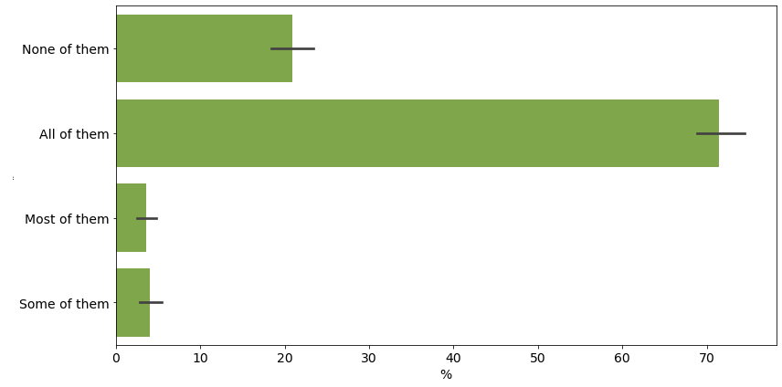
71% of respondents report that all of primary school children at home are spending time on education at home since schools were closed
Notes:
Interesting to note that almost 20% of primary school respondents are reporting not spending time on education at home.
EDU 2
*If DEM10a>0*
Did primary school-age children in your household spend time on education while schools were closed?
Note: Education includes any learning activities, not just formal distance education.
*Prompt for all/most/some if YES*
Y, all of them
Y, most of the them
Y, some of them
N, none of them

Slide 13
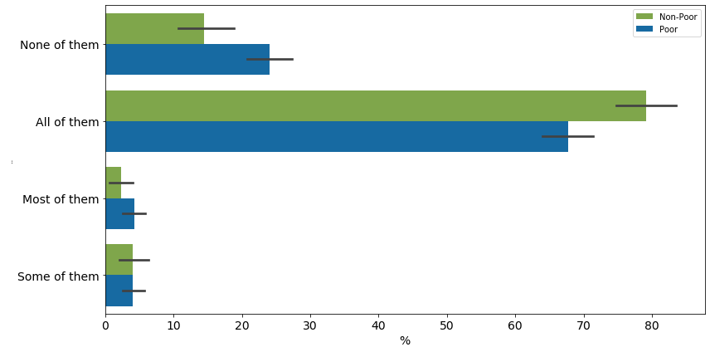
Wealthier households are more likely to report that primary school children are spending time on education at home
Notes:
EDU 2
*If DEM10a>0*
Did primary school-age children in your household spend time on education while schools were closed?
Note: Education includes any learning activities, not just formal distance education.
*Prompt for all/most/some if YES*
Y, all of them
Y, most of the them
Y, some of them
N, none of them

Slide 14
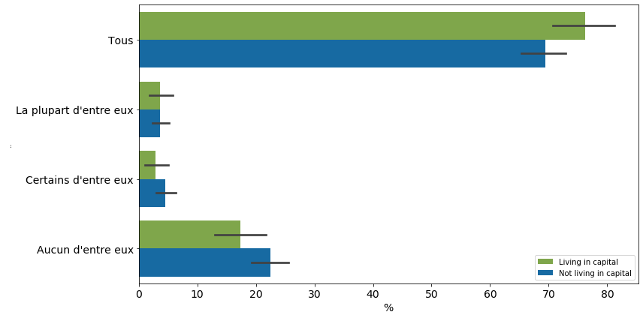
Households living in the capital and those living outside the capital were similarly likely to spend time on education while schools were closed
Notes:
EDU 2
*If DEM10a>0*
Did primary school-age children in your household spend time on education while schools were closed?
Note: Education includes any learning activities, not just formal distance education.
*Prompt for all/most/some if YES*
Y, all of them
Y, most of the them
Y, some of them
N, none of them

Slide 15
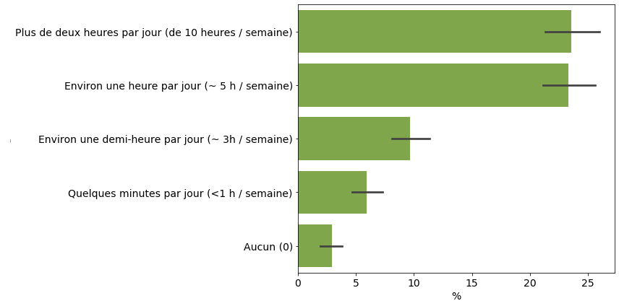
20% of children are spending 10+ hours per week on education
Notes:
edu4
*If YES to EDU 2 or 3*
On average over the most recent week of schools closures, how many hours a day did children in the household spend on education?
*Code to fit, prompt as needed*
More than two hours each day (10+ hours/week)
About one hour each day (~5 hrs/ week)
About a half hour each day (~3hrs/week)
A few minutes each day (<1 hr/week)
None (0)

Slide 16
But 50% of children are less than an hour a day on education
~ 50%
~ 50%
Notes:
Event though 70% of respondents reported that all children were spending time on education - there is wide variation in how much time. Approximately 50% of respondents are spending less than an hour a day on education

Slide 17
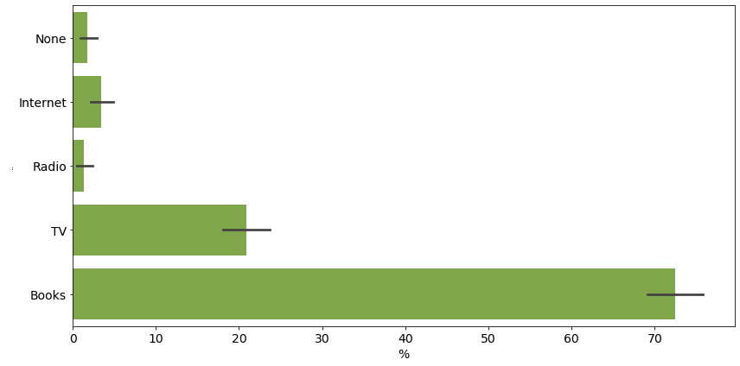
Among children in primary school, more than 70% used books to help continue their education while schools were closed
Notes:
EDU 16
Which of the following tools did school-aged children in your household use to help continue their education while schools were closed?
*Read out, mark Y/N to each*
Eneza (SMS education by chat)
Primary students engaged in distance learning
N se CI-L CI-H mean std
Eneza (SMS education by chat) 801 0.018 0.034 0.104 0.069 (0.253)
Official educational TV (RTI1, RTI2, RT3, etc…) 841 0.024 0.527 0.622 0.574 (0.495)
Radio 839 0.020 0.081 0.158 0.119 (0.324)
Livres fournis par l'école 846 0.024 0.605 0.698 0.651 (0.477)
Leurs propres livres scolaires 857 0.017 0.901 0.968 0.935 (0.247)
Books we have in the household 841 0.024 0.538 0.632 0.585 (0.493)
I/Others in my household are teaching them 864 0.024 0.565 0.658 0.611 (0.488)
MaFormation (online portal for fin de cycle stu... 820 0.019 0.056 0.130 0.093 (0.290)
https://ecole-ci.online/ 814 0.019 0.052 0.125 0.088 (0.284)
Youtube 814 0.017 0.023 0.090 0.057 (0.231)
Other Educational content on the internet 812 0.019 0.052 0.125 0.089 (0.284)
Official educational TV (RTI1, RTI2, RTI3)
Radio
Books provided by school
Their own school books
Books we have in the household
I/Others in my household are teaching them
MaFormation (online portal for fin de cycle students)
https://ecole-ci.online/
Youtube
Other Educational content on the internet
Tutoring
Other (Specify)
None

Slide 18
RECOVR Côte d’Ivoire Round 2 Education
Key Findings
Households report that 97% primary school and 94% secondary school children have returned to school (October)
Compared to 60% in Round 1 (June)
No differences between children in poor and non-poor households
Households again report that reviewing textbooks is the most popular activity children use to continue their education outside of school
32% of respondents report that their children’s teachers have been in touch with the parents at least once during lockdown
Does not vary by household poverty

Slide 19
RECOVR Côte d’Ivoire Round 2 Education
Questions on awareness, use, and perceptions of distance learning interventions
Radio
"Ma radio, mon école avec Tonton Jojo"
Television
Mon école à la maison, Classes fermées, cahiers ouverts

Slide 20
RECOVR Côte d’Ivoire Qualitative Survey
Conducted after Round 2 Quantitative Survey
Also used to investigate different user experiences of radio, television, and SMS distance learning services
Key findings related to:
Importance of parent and caregiver support and supervision
Influence of house teachers and private tutoring
Future potential of educational media interventions
Rest of presentation integrates findings from all three surveys

Slide 21
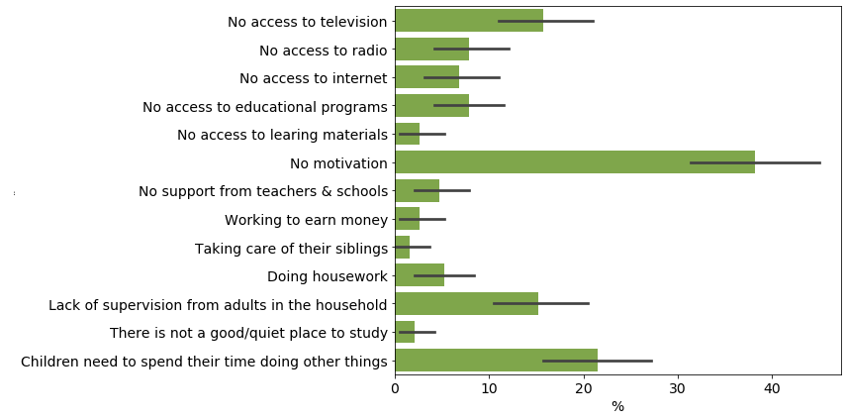
Lack of motivation is a primary barrier for children in primary school to spend time on education at home
Notes:
EDU 6
What are the main reasons children in your household are not spending more time on education during this time while schools are closed?
*Code to fit, prompt for multiple responses, up to 3*
Lack of access to television
Lack of access to radio
Lack of access to internet
Lack of access to educational programs
Lack of access to textbooks or learing materials
Lack of motivation
Lack of support from teachers and schools
Children are working to earn money
Children are taking care of their siblings
Children are doing housework
Lack of supervision from adults in the household
There is not a good/quiet place to study
Children need to spend their time doing other things
Other (specify) x3

Slide 22
Parent or caregiver involvement is critical to distance learning - adult support and supervision addresses challenge of motivation
For the child, as long as the bells don't ring to announce the resumption of classes, he always thinks he's on vacation.
Over there the child is well supervised whereas at home, when the parents are not there, he does what he wants and how he wants.
It must be said that the period of confinement was not easy: the children were no longer interested in studies, so if you don't follow them closely, they will forget everything; it's a parent's duty to follow their children. It all depends on the parents
Notes:
The qualitative survey provided some understanding to the “lack of motivation” issue - parents and caregivers felt that children needed their support and supervision. These three quotes illustrate that out of school, children often do not spend time on educational activities and that the role of parents is critical

Slide 23
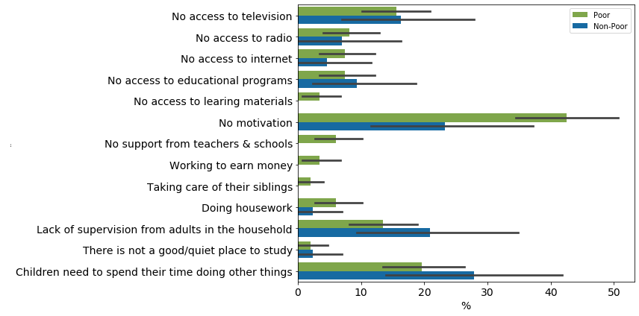
Almost 20% more poor households cited lack of motivation as a primary barrier for children in primary school to spend time on education at home
Notes:
This issue is even more important when considering the fact that the motivation issue is especially important for poor households. Nearly 20% more poor households identified “lack of motivation” as the primary barrier as compared to non-poor households. This is related to poor households probably having fewer resources, less time, and less confidence in supporting their children’s education.

Slide 24
Parent or caregiver involvement can be but is not always defined by educational background or wealth
I didn't have the means to engage a house teacher, so often if I'm at home, I tell him to study even if I cannot read. I sit next to him, he reads, and he starts memorizing so that he doesn't forget what they learned at school … We don't know what the future holds. My son I say to him "as long as I have money to pay for your studies you will go to school because I didn't attend school, you will.
As I don’t have the required academic skills, I was unable to control their work, let alone teaching them anything.
Notes:
Many parents with little educational background themselves felt they couldn’t support their children’s education - quote on the right shows a caregiver describing that they couldn’t support their child
On the left, though, we have an example of a parent who even though they couldn’t read themselves and couldn’t afford a house teacher was still actively involved in their child’s education

Slide 25
Parent or caregiver involvement can be but is not always defined by educational background or wealth
Policy Takeaway - Parent engagement should be encouraged, especially for those parents who have little educational experience themselves. Qualitative interviews can provide a model of how to support. Can also include older siblings, aunts and uncles, neighbors
I didn't have the means to engage a house teacher, so often if I'm at home, I tell him to study even if I cannot read. I sit next to him, he reads, and he starts memorizing so that he doesn't forget what they learned at school … We don't know what the future holds. My son I say to him "as long as I have money to pay for your studies you will go to school because I didn't attend school, you will.
As I don’t have the required academic skills, I was unable to control their work, let alone teaching them anything.
Notes:
Attitudes and awareness can be the first issues to address

Slide 26
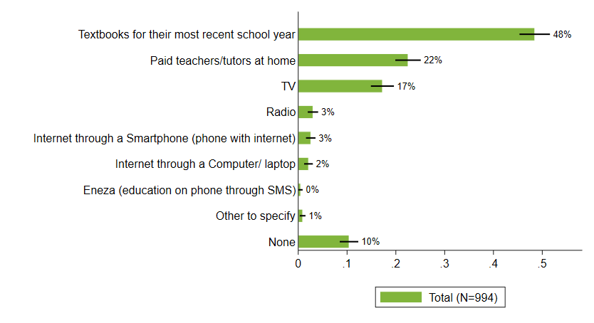
“House teachers” and private tutoring are also likely to drive educational inequality
Notes:
Another key source of inequity is likely to be the system of house teachers and private tutoring. More than 20% of households reported using house teachers

Slide 27
“House teachers” and a “shadow education” system
It's not good because when the children are at home and they don't study. They forget what they have learned. I don't have the (financial) means to engage a house teacher when I needed one for the children. It's embarrassing not to be able to afford a house teacher for our children.
I: You say that you took a teacher who went to study with the children?
R: That's right, because I didn't go to school, I can manage a little bit, so I can't help them.
For me, if I had a good level of education, and the financial means, I would have hired another teacher to help them.
Regarding education, since I'm not too much at home, I go to work. What I would like to do is to look for a house teacher for their education.
Notes:
House teachers was one of the most popular discussions in the qualitative interviews, brought up both by those who employed house teachers and by those who wished they could afford to

Slide 28
Broader discussion on education costs
House teachers are a relevant issue when schools are open and closed
Shadow education also includes “reinforcement classes”
Nowadays, there are no good teachers anymore, the children go on Wednesdays and Saturdays for reinforcement classes but it's paying. And I make the effort to pay. I take the house teacher to improve their work.
Other costs associated with attending school (Comité de Gestion des Établissements, books and scholastic materials)
We have a lot of problems like the COGES. For one child, we can pay up to 50,000 CFA francs and due to lack of means the child starts the school year in November or December. We would be happy if the COGES and school T-shirts could be abolished.

Slide 29
Broader discussion on education costs
Policy Takeaway - Further investigation is needed to understand the “shadow education” system in Cote d’Ivoire, in addition to exploring strategies for addressing educational inequality, such as remedial education programs and ways in which funding and resources can be used to cover all children
House teachers are a relevant issue when schools are open and closed
Shadow education also includes “reinforcement classes”
Nowadays, there are no good teachers anymore, the children go on Wednesdays and Saturdays for reinforcement classes but it's paying. And I make the effort to pay. I take the house teacher to improve their work.
Other costs associated with attending school (Comité de Gestion des Établissements, books and scholastic materials)
We have a lot of problems like the COGES. For one child, we can pay up to 50,000 CFA francs and due to lack of means the child starts the school year in November or December. We would be happy if the COGES and school T-shirts could be abolished.
Notes:
Policy takeaways here will depend on what the current conversation is in the Ministry and more broadly

Slide 30
Radio and television appeared to be successful strategies for disseminating information
“I: Have you heard of any other educational activities this year?
R: In the media or on the radio?
I: Have you heard of them?
R: On the radio yes or they talked about compulsory schooling and its benefits.
I: Have you heard about the children's television program?
R: Yes, I have watched
I: What did you hear?
R: We are required to send the children to school, make them comfortable and not make them carry heavy loads and fieldwork
R: When I heard about COVID on the radio, it was scary.
I: I didn't listen to the radio programs. How is the show playing on the radio?
R: It is said that the corona real, you have to protect ourselves by washing our hands and wearing masks.
Notes:
Respondents discussed hearing important information about education and public health generally over television and the radio

Slide 31
Parents and caregivers were very open to the idea of educational media but meaningful engagement with the programs could potentially be improved
“I didn't go very far in my studies, I followed [the television program] but it's really like a blind man looking at himself [he laughs]. I just tell them to study and don't go out of the house."
I: Okay, and what did you think of the show?
R: I was saying that it's not bad but the child has to face the teacher to follow the lessons. You have to be well equipped to allow the children to watch these classes at home.
I: Okay, but do you think it's good for the children?
R: I think it's good
I: Why?
R: Because I don't have the time to stay at home to look after the children.
Notes:
In relation to the educational programs, though, parents and caregivers often weren’t very involved. Here we have two quotes showing that the caregiver liked the television program explicitly because they didn’t have to be very involved

Slide 32
Pacing of radio and television programming was seen to be too fast
“If you're not focused it's difficult. The radio doesn't talk twice . . . You have to take notes. If you do not have your notebooks and your pen during the radio talks, you may not understand.”
“TV they don’t explain so good and the show is short . . . It’s fast, as soon as it starts it’s over
“The children found these programs too fast, the explanations were insufficient, we had no other choice but to comply since there were no other alternatives.”
“It’s fast for a little girl, she can’t memorize.”
Notes:
For those respondents who did watch or listen to the radio and television programs, they reported that they moved too quickly - but this might relate to parents’ and caregivers’ limited understanding of teaching and learning - as in the last quote - it’s to memorize

Slide 33
Parents and caregivers had a limited understanding of the media programs
Interviewer: What do children learn from watching the program?
Respondent: Sorry?
Interviewer: What do children learn from watching this program?
Respondent: I didn't hear
Interviewer: I'm asking: What do you think children learn from watching this program?
Respondent: [long silence]
Interviewer: Hello
Respondent: Yes, they learn the courses, what they watch on TV; that's what they learn.
Interviewer: What do children learn from watching the show?
Respondent: I'm the one who makes them watch the show.
Interviewer: No, I mean what do they themselves learn by watching?
Respondent: They learn to remember what the teacher says.
Interviewer: ok
Respondent: They learn how to memorize the principal parts of the courses taught
Notes:
We previously saw quotes from respondents who didn’t watch or listen along with their children - but then we’ve seen for those respondents who did, they have a limited understanding of these programs. It seems like they expect children to memorize what the teachers are saying

Slide 34
Parents and caregivers had a limited understanding of the media programs
Interviewer: What do children learn from watching the program?
Respondent: Sorry?
Interviewer: What do children learn from watching this program?
Respondent: I didn't hear
Interviewer: I'm asking: What do you think children learn from watching this program?
Respondent: [long silence]
Interviewer: Hello
Respondent: Yes, they learn the courses, what they watch on TV; that's what they learn.
Interviewer: What do children learn from watching the show?
Respondent: I'm the one who makes them watch the show.
Interviewer: No, I mean what do they themselves learn by watching?
Respondent: They learn to remember what the teacher says.
Interviewer: ok
Respondent: They learn how to memorize the principal parts of the courses taught
Policy Takeaway - Radio and TV programs should include explicit instructions to have an older sibling or adult listen or watch along with children and support their distance learning. Children can also be encouraged to have a pen and paper available.
Policy Takeaway - Radio and TV can also be a method for educating parents that learning is more than just memorization

Slide 35
Mixed views on whether services should continue
“Now that the schools are open, students will not be watching these programs.”
“Because, even in classroom, children don't often follow and can't understand; and then on the radio; I don't think it can help them.”
“If it continues, it can help those who haven't done the courses to get up to speed. What some people didn't understand in the course may be something they can understand on TV or radio.”
“These programs can continue, but on children's days off while making sure to define a precise schedule of presentations on either radio or television.”
Notes:
First two quotes show respondents who aren’t supportive of the continuance of these programs. Second two quotes show respondents who are supportive -

Slide 36
Mixed views on whether services should continue
“Now that the schools are open, students will not be watching these programs.”
Policy Takeaway - Future programming should build on respondents’ suggestions - address the timing of the programs and parents’ and caregivers’ belief in the importance of repetition. Radio and TV and other programs could be presented as “reinforcement courses”
“Because, even in classroom, children don't often follow and can't understand; and then on the radio; I don't think it can help them.”
“If it continues, it can help those who haven't done the courses to get up to speed. What some people didn't understand in the course may be something they can understand on TV or radio.”
“These programs can continue, but on children's days off while making sure to define a precise schedule of presentations on either radio or television.”
Notes:
First two quotes show respondents who aren’t supportive of the continuance of these programs. Second two quotes show respondents who are supportive -

Slide 37
Students most frequently use textbooks to continue their educations at home, TV is more popular than radio
Notes:
Now we’ll provide some feedback on the specific programs

Slide 38
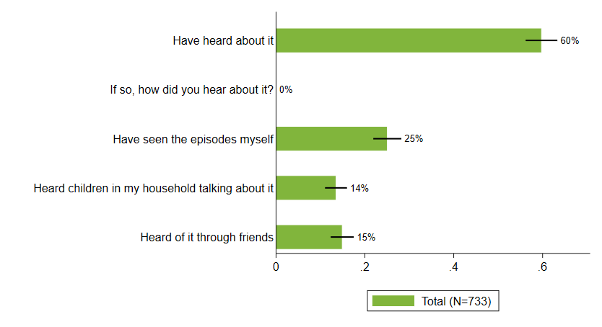
60% of respondents with children had heard of the TV show "Mon école a la maison, classes fermées, cahiers ouverts" & a quarter have seen episodes themselves

Slide 39
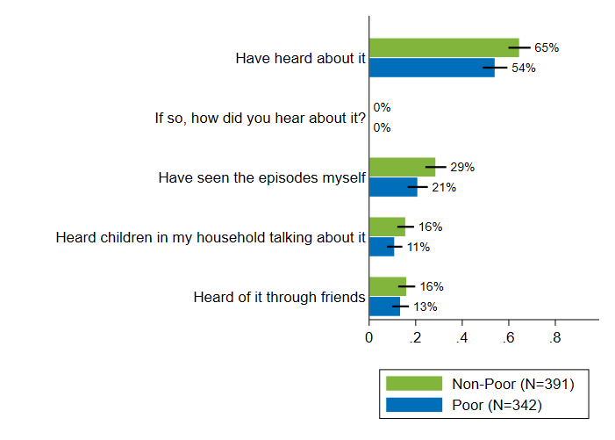
A larger proportion of non-poor parent respondents have heard of the TV show "Mon école a la maison, classes fermées, cahiers ouverts" & a greater proportion has also seen episodes themselves
Notes:
We would expect this finding - Television is more prevalent among non-poor households

Slide 40
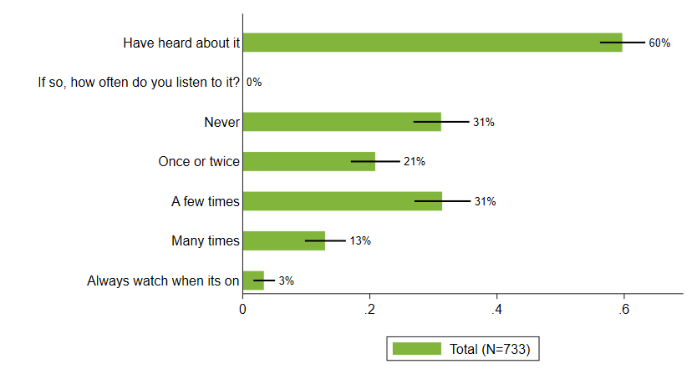
Of parent respondents that had heard of the show, a third had never watched it

Slide 41
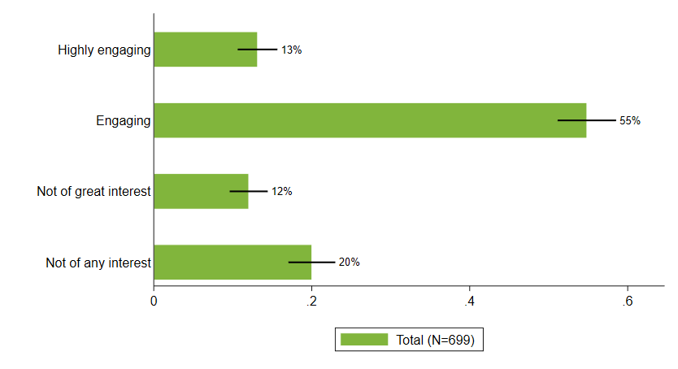
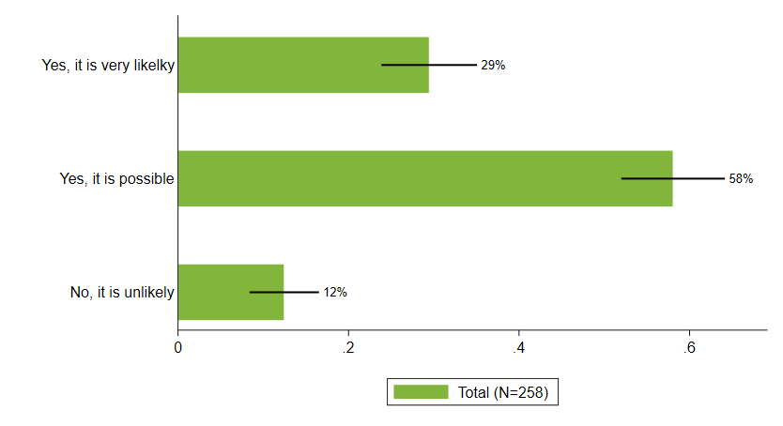
More than half of respondents find the show engaging and nearly one third would likely recommend it to others
edu39c, edu40

Slide 42
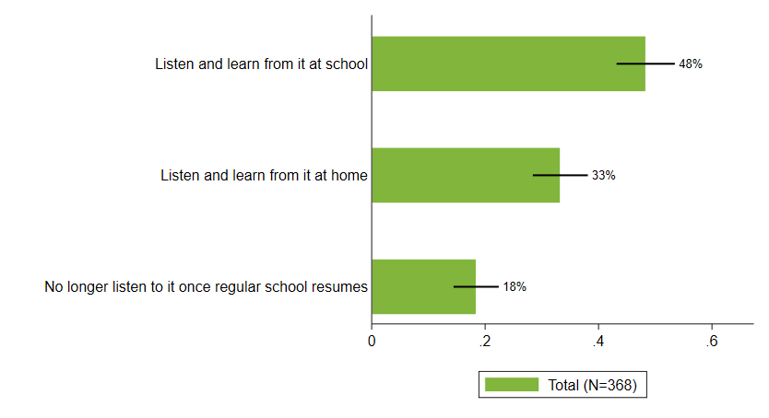
Nearly half of parents prefer for secondary school students to continue with the TV show at school once school resumes

Slide 43
Audio visual of television appealed to some respondents
“This [TV] is more important than for radio because it's visual”
“Our problem is that ideally we are more audio-visual. We don't listen to really the radio. I know that I once listened to the show about education; but since I had the opportunity to follow it on TV as well, we tried to focus on the visual;”

Slide 44
But radio could have some advantages
I: What was most important to you in the way your children spend their time outside of school?
R: They help us in the fields, but during the vacations they have taken some courses on television.
I: Ok what responsibilities do they have at home?
R: I know that they are often their moms.
I: What to do?
R: To clean, then to cook
I: During the lockdown, how did they occupy their time?
R: As I said earlier, they help us in the fields. When we are in the field, they listen to the radio to study, but once in the village they watch television.
Notes:
It is difficult to make comparisons between radio and television as they represent different audiences and are confounded by access to these devices

Slide 45
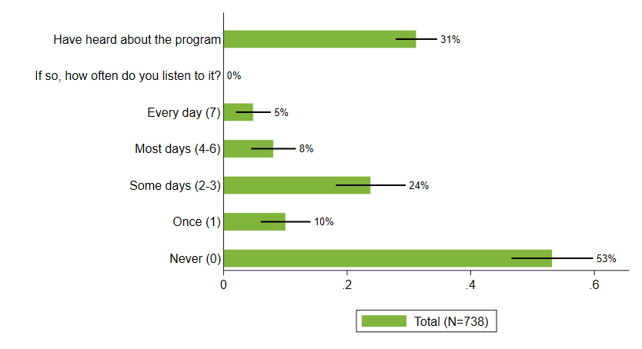
31% of respondents have heard of the "Ma radio, mon école avec Tonton Jojo" radio program, though more than half of those never listened to it

Slide 46
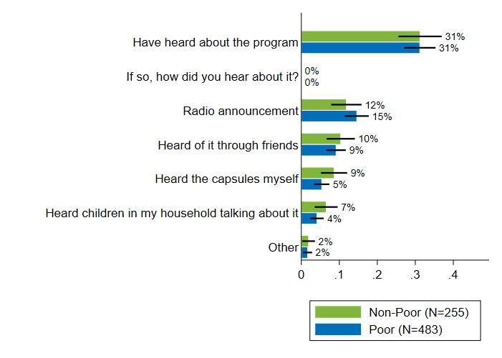
Poor and non-poor respondents have similar familiarity with and sources for "Ma radio, mon école avec Tonton Joe"
Notes:
Whereas with television, we saw a difference in awareness between poor and nonpoor households, we do not see that with radio

Slide 47
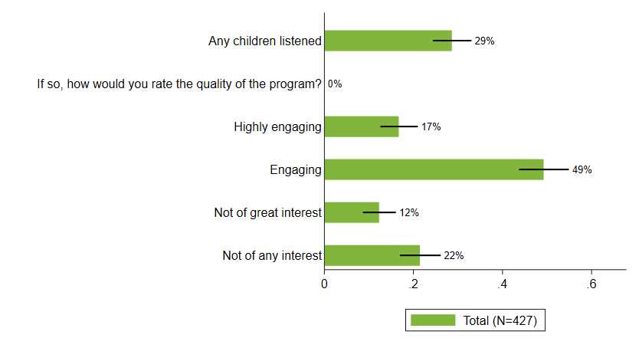
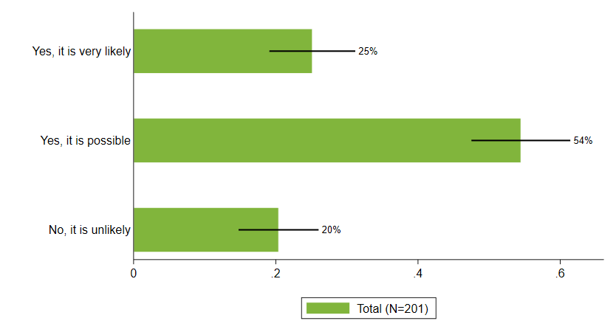
66% respondents with children who listen to the show consider the it to be highly engaging or engaging, and one quarter would recommend it to others
edu29c,edu30

Slide 48
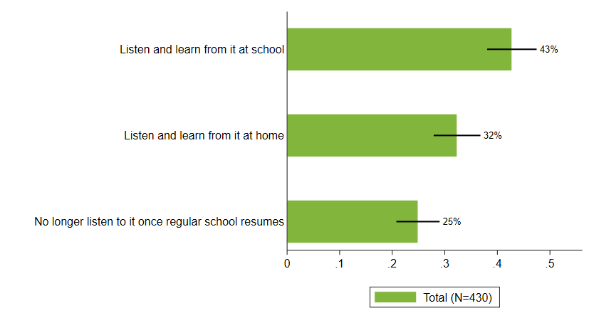
25% of parents indicate that they would prefer children no longer listen to the show once regular school resumes

Slide 49
Some respondents were skeptical of Eneza and cell phone use
I: What about SMS and then cell phone programs, do you think they should be maintained even though the containment is over?
R: I have a problem with SMS because at home, as long as the child hasn't passed the BAC, he is not allowed to use the phone because children do stupid things. Therefore, when the children are younger, I do not give them a phone. One of them just got his BAC and we just gave him his phone.
“At the beginning I said it was good, but if you don't have money for Internet, you will miss the course.”
“I couldn't be interested since not all of my children have a phone to receive lessons with messages.”

Slide 50
Some respondents saw its advantages
R: Because nowadays kids use the phone; they're hooked on the phone if things come in via SMS they'll look at it and say there's an exercise. It's a challenge for them and they're going to look for it. I think it needs to be maintained
Asynchronous delivery platform can be helpful (as compared to TV and radio)
I: Do you think the SMS and cell phone programs should be continued?
R: It can continue
I: and why
R: Because in this case at least the courses are in the phones even if you don't have time, you can study later and what you don't understand you come back to see. I think the SMS application is better than TV and radio programs.
I: okay
R: the SMS is in the phone from where you can review the text message

Slide 51
As with radio and TV, caregivers often have limited involvement
I: Okay, but did the children in your household like it? Did they like the program?
R: Yes, they liked it. They themselves mastered it well, they liked it a lot.
I: Do you think that the children have learned by engaging in this program?
Did they learn?
R: Yes, they learned something
I: Hello?
R: Yes Hello?
I: I was saying did the children learn from this program? Did they learn anything by participating in this program?
R: What I can say
I: yes
R: They learned a lot, I gave them the phone to study but I didn't try to find out what they were learning, whether they liked it or not.
I: Okay. Did the children take the courses through the application of Eneza
R: Yes, those who have cell phones were taking the courses.
I: Fine. Did they like the program?
R: Of course they liked it otherwise they wouldn't keep it in their cell phone.
I: ok, can you describe your involvement with Eneza? What did you like or dislike about this App?
R: As children are the ones who use the application and if they installed it, it's because they are interested in it and it also advises them.

Slide 52
Concern for those without access to TV, radio, or electricity
R: In fact, in the villages, people put the study programs on television. I have laughed about it because for the child, or the parent who is in a remote place, who doesn't have access to television or radio, can they care whether the child is watching the programs on television or not? The interest was much more for urban dwellers where parents had the opportunity to assist and watch over their children with these things.
I: Do you mean that your children did not watch or follow these programs, neither on the radio nor on television?
R: We were not interested, because, on the one hand, we were not informed in the village. We had no inspector, no Regional Director, no pedagogical advisor to inform villagers about the existence of such programs.

Slide 53
Concern for those without access to TV, radio, or electricity
I: In spite of everything, the villages have access to electricity. Do you have access to television?
R: No, not all villages have electricity, not all of us have access to television. For example, in my village, there is no electricity. Despite the fact that my house is located nearby the road. I still don't have electricity. We use solar panels at home. However, we don't have the possibility to watch TV since during the day the solar panel is used to recharge the power battery, and in the evening we can just watch the news and some movies here and there. So, we were not informed of the television, but rather in the streets where the information was conveyed, so the information was not taken seriously.

Slide 54
Summary of Possible Policy Recommendations
Radio and television seem to be effective strategies for disseminating information in Côte d’Ivoire. Sharing key insights through these mediums – from public health practices to emphasizing the importance of education – should continue.
Radio and television could also be used to experiment with new content – such as emphasizing the importance of parental engagement – and new messaging strategies – such as encouraging debate – to build on existing communication networks, generate discussion, and involve the family, neighbors, and colleagues of radio and television owners and not just the owners themselves.
Additional strategies for reaching and supporting the most remote populations should be explored so that there are interventions that are appropriate for these contexts and also so that these populations feel like they are the intended audience and not overlooked.

Slide 55
Summary of Possible Policy Recommendations
Programming for radio and television should be adjusted so that the pacing and content are easy to follow. These programs could also consider including explicit instructions for older siblings or caregivers to support children’s participation or for children to be prepared with a pen and paper in order to listen or watch.
The rise of private tutoring in Côte d’Ivoire should be further explored. Strategies for mitigating educational inequality should be investigated in tandem.
Strategies for increasing parental involvement should be developed with a particular focus on communicating that even if parents have limited educational experience themselves, they still play a very important role in their children’s education.
Caregivers and other stakeholders’ understanding of the learning process should be further explored and it might be useful to consider ways to combat the perception that learning is memorization.

Slide 56
More detailed slides for reference

Slide 57
RECOVR Côte d’Ivoire Quantitative Surveys
Random sample from Integrated Regional Survey on Employment and in the Informal Sector (ERI-ESI 2017)
Initial reliability test 42 out of a 100 phone numbers were still reachable and the same people picking up the phone.
Generated random sample of 3,022
Approximately a third of sample from EA in Abidjan, two thirds from EA outside of Abidjan
3,022 call attempts - total sample of 1,329 (44% response rate)
Comparison
Ghana RECOVR Survey
Random Digit Dialing
1,357 respondents out of 10,781 call attempts (12% response rate)

Slide 58
RECOVR Côte d’Ivoire Qualitative
More deeply investigate parents’ and caregivers’ experience of the school closures, as well as awareness, use, and perceptions of distance learning options
Semi-structured protocol
Approximately an hour phone survey
Sampled from Round 2 Quantitative Survey
Understand different perspectives and user experiences
Oversampling different user profiles

Slide 59
Responses to Round 2 Quantitative Survey used to Generate Qualitative Survey Sample
Between June and the start of this school year in September, which of the following tools were primary school-aged children in your household using to help continue their education?

Slide 60
Using Quantitative Survey Responses to Generate Qualitative Sample
How would you rate the quality of “Ma radio, mon ecole avec Tonton Jojo” in terms of engaging child in learning?

Slide 61
Qualitative Survey Sample

Slide 62
RECOVR Côte d’Ivoire Qualitative
Key Findings
Semi-structured protocol
Approximately an hour phone survey
Sampled from Round 2 Quantitative Survey
Understand different perspectives and user experiences
Oversampling different user profiles

