Slide 1

Safety First: Improving Access to Quality Health Services in Kenya
Kenya Patient Safety Impact Evaluation (KePSIE)
Kenya Evidence Forum - June 14, 2016
Using Evidence to Improve Policy and Program Designs

Slide 2
What percentage of health facilities comply with minimum patient safety standards in Kenya as per current regulation?
20%
3%
65%
90%

Slide 3
We do not know…
But based on our baseline data collection in all facilities in Kakamega, Kilifi and Meru (~1,100 HFs)
3% of facilities comply with minimum patient safety standards

Slide 4
What percentage of procedures are performed with new (as opposed to reused) needles and syringes in Kenya?
57%
21%
100%
78%

Slide 5
Based on the same baseline
(~19,000 observations of HCW-patient interactions )
100% of procedures were conducted with new syringes and needles

Slide 6
Two important messages to start…
Policy action is required to move facilities above minimum patient safety standards
Kenya has done a great job in a key area: new needles and syringes

Slide 7
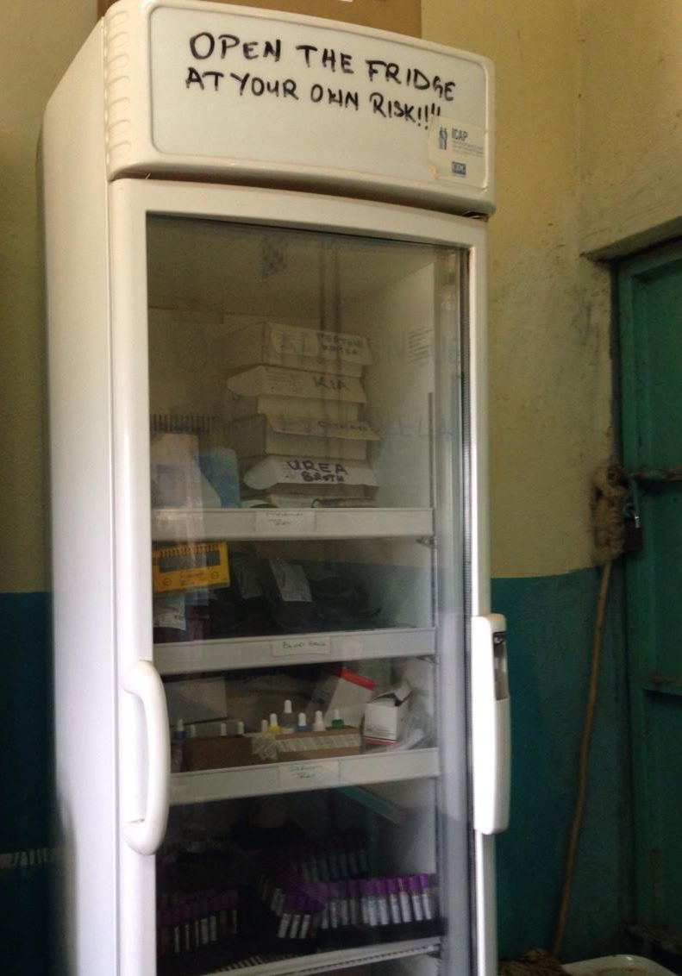
Can inspections help improve patient safety in Kenya?

Slide 8
Constraints Identified in the Health Inspections System (Windsor, 2013)
Rules/Standards
Discretionary
Not well known
Monitoring/information systems
Low probability of inspection (4-8%)
No capacity to follow-up
No monitoring system (paper records)
Limited information to HFs
Enforced Sanctions and rewards
No warnings or sanctions, but extreme cases
Weak incentives for HFs to improve patient safety

Slide 9
“Windsor Agreement,” 2013
KePSIE
A country-led initiative developed by consensus
Support regulatory reform of the inspections system;
Develop instruments to measure and monitor patient safety
Evaluate the impact of accountability mechanisms–through different models of health inspections–on patient safety
Building on the long-term Health in Africa Initiative work on regulatory reform

Slide 10
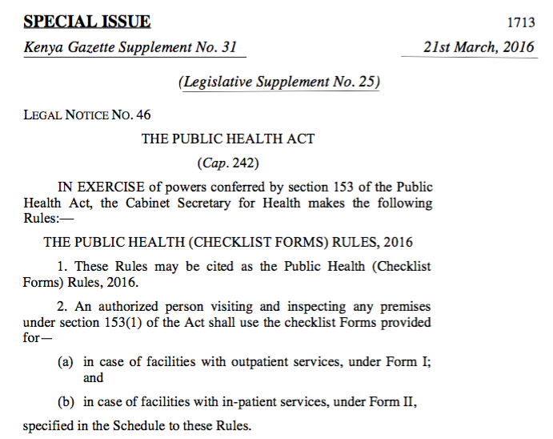
✔
1. New Regulatory Framework Gazetted in 2016
Standardized
Checklist
Warnings & Sanctions
Risk-based Scoring system
For private and public facilities (only private facilities were inspected before)

Slide 11
✔
2. Measuring Patient Safety – select results (I)
Census in all facilities in 3 study counties (Kakamega, Kilifi, Meru)
97% of facilities need to improve above minimum score
1
Facility Performance on Patient Safety
(Percentage of Facilities, 3 study counties)
300+ items
2
Public facilities score better than private facilities
66% of facilities are private but 71% of patients are attended in public facilities

Slide 12
✔
2. Measuring Patient Safety – select results (II)
Census in all facilities in 3 study counties (Kakamega, Kilifi, Meru)
Hand hygiene is only performed in 2% of the cases when it is indicated (cornerstone of IPC)
3
HCW knowledge and access to supplies do not always help with safety practices (Know-Do Gap)
4
Hand Hygiene Before Injection or Blood Draw

Slide 13
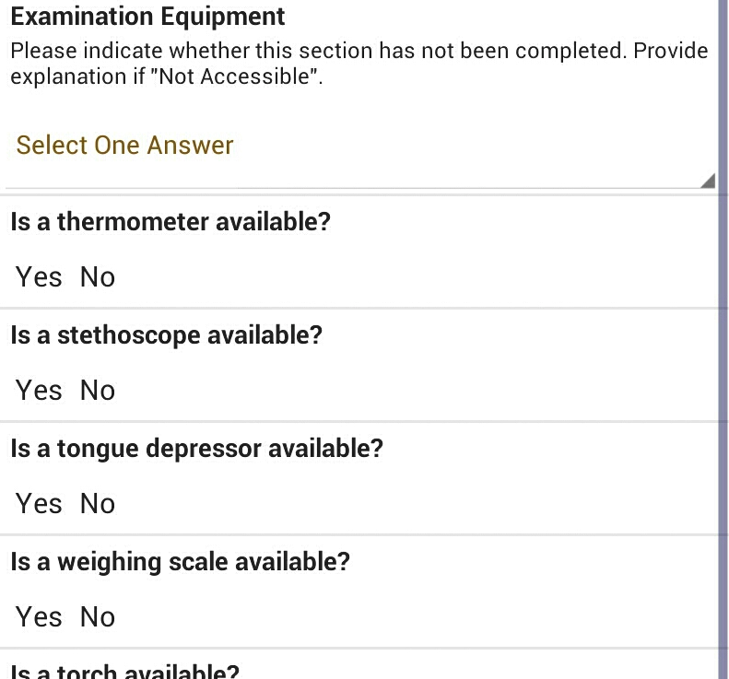

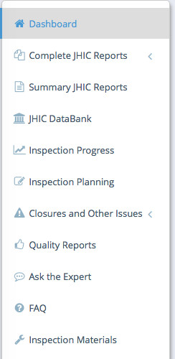


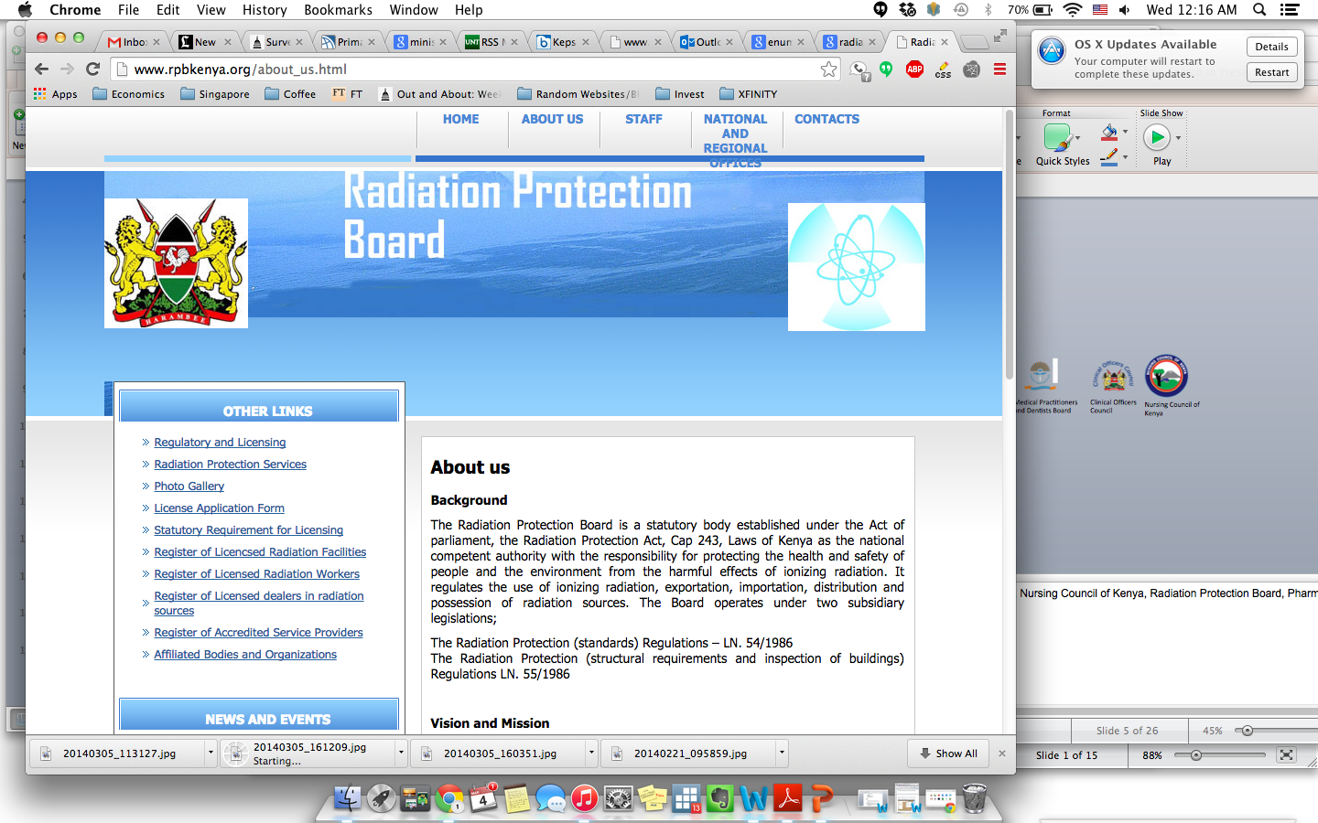



What is coming next→
3. Evaluation of intensive inspections
1
Training the first cadre of full-time inspectors
2
Electronic Inspections
Web-based Monitoring System with detailed performance of all facilities
3

Slide 14
Implementation
Intensive inspections
100% probability of inspections
Enforcement of warnings and sanctions
Disclosure of facility performance
In context: Kenya is one of the only 5 countries (out of 45 in SSA) that actually conduct inspections in health facilities
To be continued
Notes:
This isn’t the full gazetted joint inspections checklist.

Slide 15
KePSIE Team
Thank you!
Guadalupe Bedoya
Jishnu Das
Jorge Coarasa
Amy Dolinger
Ana Goicoechea
Njeri Mwara
Khama Rogo
Frank Wafula

