Slide 2


Improving Efficiency in Courts
Judicial Performance Improvement Project
Kenya Evidence Forum - June 14, 2016
Using Evidence to Improve Policy and Program Designs
Notes:
*What I hope to convince you of by the end of this presentation is how quality data can empower decision making

Slide 3
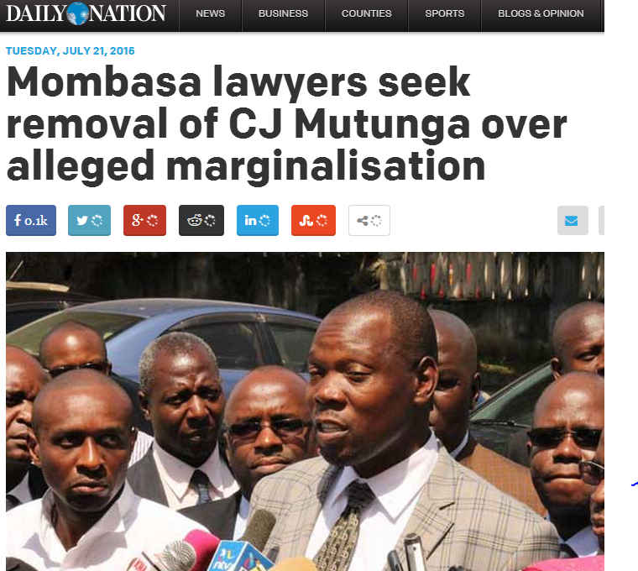
Notes:
Data helps us respond to a public relations problem
July 2015 Mombasa lawyers claimed that the court was being marginalized because magistrates are being transferred away, and so they were advocating for the removal of Chief Justice Willy Muttunga from power

Slide 4
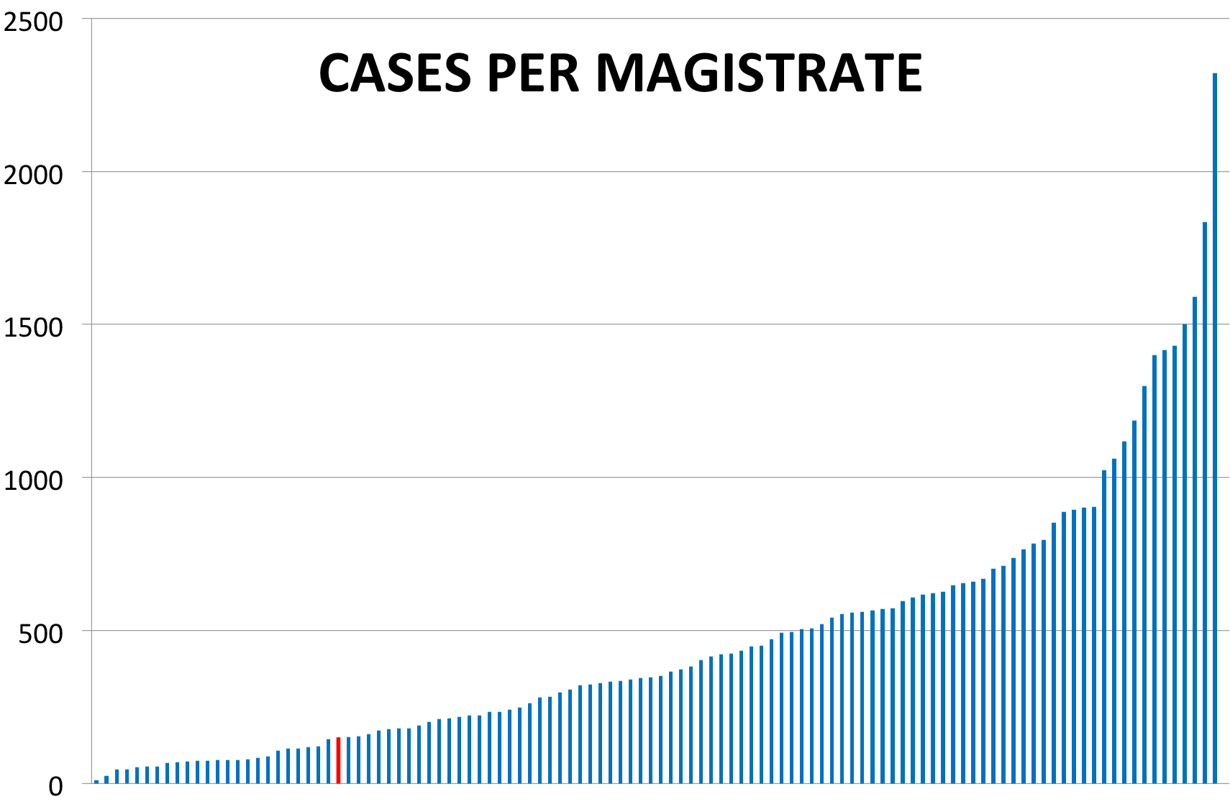
Mombasa
Notes:
This is the accumulated pending cases in the courts as of June 2013. We have deliberately removed the courts names to encourage you to focus on the graph from an elevated perspective, or the national level, of the distribution of cases between courts.
Notice the extreme discrepancies amongst the courts. The average caseload per magistrate is 475 but some court have a caseload as high as 2322 while in other it’s as low as 12!
OTHER THAN TYPE OF CASE, WHAT COULD BE THE MAIN REASONS FOR THIS VARIATION?
Data source: Judiciary Case Audit and Institutional Capacity Survey. Volume 1. Collected in December 2013 and January 2014. Data findings were printed August 2014.

Slide 5
There were other questions…
Why do cases take a long time?
Are judicial officers putting in different levels of effort?
What resources do court staff need to improve the delivery of judicial services?

Slide 6
Judicial Performance Improvement Project (JPIP)
Project 2012 – 2018
  Increasing access to courts
  Improving timeliness of judicial services
  Enhancing performance and quality of decision making
IE discussions began 2013
Key targets and outcomes:
  Improving times to resolution and thereby reducing case backlog
  Monitoring and ensuring quality of service

Slide 7
The process of building a better data system
Improve tools
  Simple and easy to use
  Comprehensive
  Update and standardize indicators
Implement nationwide and improve compliance
  Ensure accurate and consistent reporting
  Assure sustainability

Slide 8
Building better data systems
Case tracking tool
  Daily Court Returns Template
DCRT Committee:
  Office of the Chief Justice
  Performance Management Directorate
  Information and Communication Technology Directorate
  Registrars (High Court and Magistrate Court)
  IE Research Team (World Bank and Center for Global Development)

Slide 9
Working Together…
Stakeholder meetings
Weekly committee meetings
Fully embedded with PMD
Regularly communicate with IE Research Team:
  Consider international best practice
  Incorporate data validation techniques
  Build capacity for analysis
Notes:
*Participatory, but it was really the commitment of the stakeholders

Slide 10
Daily Court Returns Template

Slide 11
Compliance
Chief Justice official communication to heads-of-court stations October 2015
94% of courts are regularly reporting their DCRT

Slide 12
What be measured using DCRT:
  All analysis can be done at the court or the judicial officer level:
  Types of matters handled
  # of cases initiated
  # of cases resolved
  Age of cases
  Stage case is in the court process
  Reasons for adjournment

Slide 13
Kinds of decisions now being made
Performance contracts
Budgetary considerations (e.g. case load)
Planning for court expansion and refurbishment
Judicial officer and staff transfers
State of the Judiciary and Administration of Justice Report, (SoJAR)
Impact evaluation measurable outcome of interest
  Time to Resolution

Slide 14
Thank you!

