Slide 1
Big Data & The Road to Safety

Slide 2
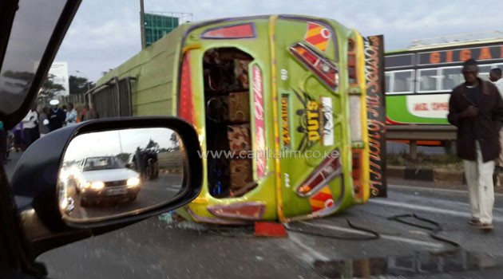
the problem
Kenya ranks top 10 countries for death rate due to road traffic accidents
Minibuses (matatus) transport 70% of the labor force
28% of matatus will be in an accident in any given year
Economic costs 1-5% of GDP
Lack of accountability in the public transport system→ moral hazard, adverse selection
No information
Perverse incentives
Inadequate rules of the game

Slide 3
innovation a platform for safety in rapidly growing cities in low-income countries
Empirically validated measurement system
Big data system
Adaptive experimentation to solve development problems

Slide 4
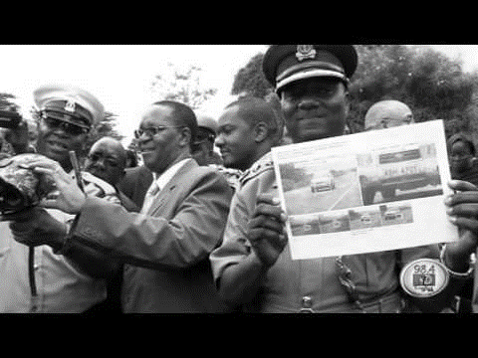
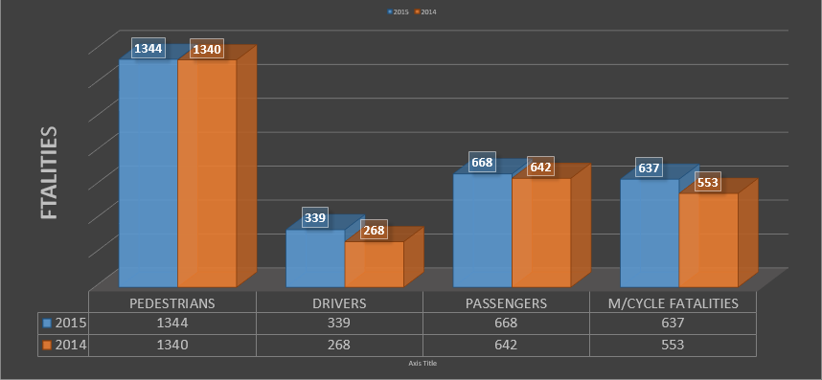
break from the past
TODAY
Speed cameras
Speed governors
Seat belts
Stickers
Poor information on accidents and casualties
No clear reduction in fatalities
TOMORROW
Big data and functioning accountability system will be the road to safety for millions of people in low-income countries
Saving lives!

Slide 5
IDEA 1: EMPIRICALLY-VALIDATED MEASUREMENT SYSTEM
WHAT FACTORS PREDICT ROAD TRAFFIC ACCIDENTS?
Physical characteristics of the road
Traffic patterns
Driver behavior
HOW DO WE COLLECT DATA IN A COST-EFFICIENT WAY?
Testing technology-based data generation
Crowd-source rider-generated data
Triagulate with observation-intensive data
Evaluate trade-offs and select cost-efficient sustainable data collection path

Slide 6
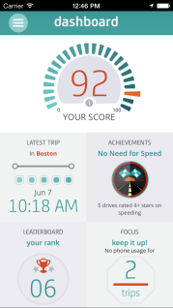
IDEA 2: CONSTRUCT BIG DATA SYSTEM
Collect essential data
Create essential piece of infrastructure that can be replicated across the world
Develop analytics strategies to make informed decisions about the needs of transport in developing countries
Show how Big Data can impact everyday lives

Slide 7
IDEA 3: EXPERIMENTALLY TEST DIFFERENT RULES OF THE GAME TO INFORM ACCOUNTABILITY RELATIONSHIPS
partner with regulator-insurer-owners-drivers-riders
generate knowledge on the factors that define a well-functioning accountability structure in weak-capacity contexts
conduct structured set of field experiments to test provision of information and incentives to matatu owners, drivers and riders
use early findings to build new set of experiments
find combination of interventions that is most effective in reducing Road Traffic Accidents

Slide 8
Align partners incentives to develop scalable strategies
Wi-Fi hotspot &
entertainment
GPS & sensors
Policy & regulation
Kenya
Africa
World
50% of matatu insurance market
Expand road safety IEs
Take to other low-income contexts
Export to major urban centers in Africa & beyond

Slide 10
research team
Guadalupe Bedoya
TAKING SAFETY SERIOUSLY!
Economist in the Development Impact Evaluation team at the World Bank's Research Group. PI of impact evaluation projects in Kenya, Peru, and Afghanistan. Focus on developing and measuring the impact of accountability systems to improve safety (patient safety, building safety, road safety).
Arianna Legovini
IMPACT EVALUATION AT SCALE!
Head of DIME. $300M in external funding over the past decade. Bridging the gap between policy and research. Triggering policy change on the basis of field experiments. Founded large experimental research programs in new fields.
Sarah Williams
DRIVING THE digitalMATATUS!
Assistant Professor of Urban Planning and Technology and the Director of the Civic Data Design Lab at Massachusetts Institute of Technology (MIT). Williams has been named one of the top 25 planners in technology and 2012 Game Changer by Metropolis Magazine.
Syon Bhanot
IT’S BEHAVIOR STUPID!
Assistant Professor of Economics at Swarthmore College. Academic Affiliate at the Busara Center for Behavioral Economics. Field experiments on decisions where individuals lack sufficient context to make optimal choices. Environmental conservation, financial decisions, cooperation, and decisions by the very poor.

